Slide 1
Lesson 11
Short-Term Financing

Slide 2
Objectives
Understand the sources and types of spontaneous financing.
Calculate the annual cost of trade credit when trade discounts are forgone. l Explain what is meant by “stretching payables” and understand its potential drawbacks.
Describe the various types of negotiated (or external) short-term financing.
Identify the factors that affect the cost of short term borrowing.
Calculate the effective annual interest rate on short-term borrowing with or without a compensating balance requirement and/or a commitment fee.
Understand what is meant by factoring accounts receivable.

Slide 3
Spontaneous Financing
Trade liabilities Money owed to suppliers.
Trade credit Credit granted from one business to another.
Draft A signed, written order by which the first party (drawer) instructs a second party (drawee) to pay a specified amount of money to a third party (payee). The drawer and payee are often one and the same.
Payment on the Final Due Date. In this section we assume that the firm forgoes a cash discount but does pay its bill on the final due date of the net period “2/10, net 30,”

Slide 4
example
the firm has the use of funds for an additional 20 days if it does not take the cash discount but pays on the final day of the net period. For a $100 invoice, it would have the use of $98 for 20 days, and for this privilege it pays $2. (This is the result of paying $100 thirty days after the sale, rather than $98 ten days after the sale.) Treating this situation as equivalent to a loan of $98 for 20 days at a $2 interest cost, we can solve for the approximate annual interest rate (X%) as follows:
$2 = $98 × X % × (20 days/365 days)
Therefore, X % = (2/98) × (365/20) = 37.2%

Slide 5
Spontaneous Financing (cont.)
Stretching accounts payable Postponing payment of the amount due to suppliers beyond the end of the net (credit) period; also called leaning on the trade.

Slide 6
The possible costs of stretching accounts payable include
* The cost of the cash discount (if any) forgone.
* Late payment penalties or interest that “may” be charged, depending on the industry practice.
*The possible deterioration in credit rating, along with the firm’s ability to obtain future credit

Slide 7
Accrued expenses: Amounts owed but not yet paid for wages, taxes, interest, and dividends. The accrued expenses account is a shortterm liability

Slide 8
Negotiated Financing
Money Market Credit
*Commercial paper Short-term, unsecured promissory notes, generally issued by large corporations (unsecured corporate IOUs)
*Letter of credit (L/C) A promise from a third party (usually a bank) for payment in the event that certain conditions are met. It is frequently used to guarantee payment of an obligation.
*Bankers’ acceptances (BAs) Short-term promissory trade notes for which a bank (by having “accepted” them) promises to pay the holder the face amount at maturity.

Slide 9
Unsecured Loans
Unsecured loans A form of debt for money borrowed that is not backed by the pledge of specific assets.
Secured loans A form of debt for money borrowed in which specific assets have been pledged to guarantee payment.
Line of credit (with a bank) An informal arrangement between a bank and its customer specifying the maximum amount of credit the bank will permit the firm to owe at any one time.
Revolving credit agreement A formal, legal commitment to extend credit up to some maximum amount over a stated period of time
Commitment fee A fee charged by the lender for agreeing to hold credit available.

Slide 10
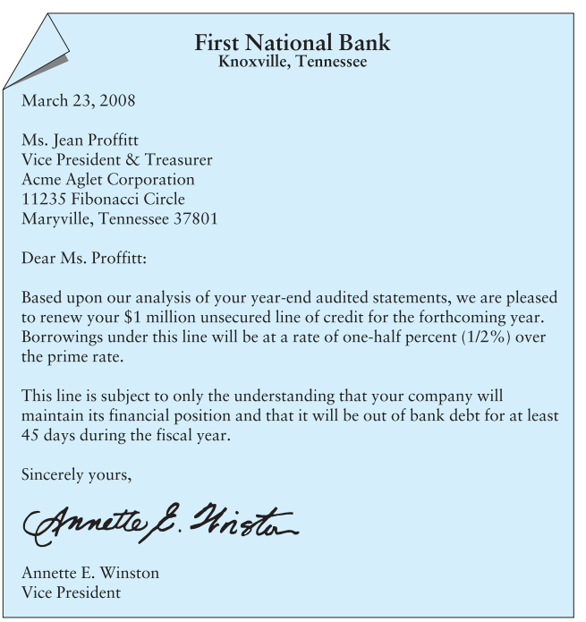
Sample letter extending a line of credit

Slide 11
Prime rate Short-term interest rate charged by banks to large, creditworthy customers. It is also called simply prime.
London interbank offered rate (LIBOR) The interest rate that world-class banks in London pay each other for Eurodollars
SIBOR stands for Singapore Interbank Offered Rate
Compensating balance Demand deposits maintained by a firm to compensate a bank for services provided, credit lines, or loans.

Slide 12
Secured (or Asset-Based) Loans
Security (collateral) Asset(s) pledged by a borrower to ensure repayment of a loan. If the borrower defaults, the lender may sell the security to pay off the loan
Uniform Commercial Code Model state legislation related to many aspects of commercial transactions that went into effect in Pennsylvania in 1954. It has been adopted with limited changes by most state legislatures
Floating lien A general, or blanket, lien against a group of assets, such as inventory or receivables, without the assets being specifically identified.

Slide 13
Chattel mortgage A lien on specifically identified personal property (assets other than real estate) backing a loan
Trust receipt A security device acknowledging that the borrower holds specifically identified inventory and proceeds from its sale in trust for the lender
Terminal warehouse receipt A receipt for the deposit of goods in a public warehouse that a lender holds as collateral for a loan
Field warehouse receipt A receipt for goods segregated and stored on the borrower’s premises (but under the control of an independent warehousing company) that a lender holds as collateral for a loan

Slide 14
Questions
1. Explain why trade credit from suppliers is a “spontaneous source of funds.”
2. Trade credit from suppliers is a very costly source of funds when discounts are lost. Explain why many firms rely on this source of funds to finance their temporary working capital.
3. Stretching payables provides “free” funds to customers for a short period. The supplier, however, can face serious financial problems if all of its customers stretch their accounts. Discuss the nature of the problems the supplier may face, and suggest different approaches to cope with stretching.
4. Suppose that a firm elected to tighten its trade credit policy from “2/10, net 90” to “2/10, net 30.” What effect could the firm expect this change to have on its liquidity?
5. Why are accrued expenses a more spontaneous source of financing than trade credit from suppliers?
6. Why is the rate on commercial paper usually less than the prime rate charged by bankers and more than the Treasury bill rate?
7. Why would a firm borrow bank funds at higher rates instead of issuing commercial paper?

