Slide 1

Entrepreneurship: Successfully Launching New Ventures
Seventh Edition
Chapter 4
Introduction to Entrepreneurship
Copyright © 2025, 2019, 2016 Pearson Education, Inc. All Rights Reserved
Notes:
If this PowerPoint presentation contains mathematical equations, you may need to check that your computer has the following installed:
1) MathType Plugin
2) Math Player (free versions available)
3) NVDA Reader (free versions available)
Slides in this presentation contain hyperlinks. JAWS users should be able to get a list of links by using INSERT+F7

Slide 2
Learning Objectives (1 of 2)
1.1 Describe entrepreneurship, corporate entrepreneurship, and the characteristics of entrepreneurial firms.
1.2 Discuss three main reasons people decide to become entrepreneurs.
1.3 Identify four main characteristics of successful entrepreneurs.
1.4 Explain five common myths regarding entrepreneurship.
1.5 Describe the three types of startup firms.

Slide 3
Learning Objectives (2 of 2)
1.6 Discuss the changing diversity of new entrepreneurs.
1.7 Discuss the positive effects of entrepreneurship and entrepreneurial firms on economies and societies.
1.8 Explain the entrepreneurial process.
1.9 Learn how understanding entrepreneurship and the entrepreneurial process can facilitate your career success.

Slide 4
Introduction to Entrepreneurship (1 of 3)
There is tremendous interest in entrepreneurship in the United States and around the world.
According to a G E M study, one out of every six American adults is engaged actively in starting a business or is the owner/manager of a business that is less than three-and-a-half-years old.

Slide 5
Introduction to Entrepreneurship (2 of 3)
Books
  Amazon.com
  lists over 30,000 books about
  entrepreneurship, 60,000 focused on business startups, and over 100,000 books concerned with small businesses.

Slide 6
Introduction to Entrepreneurship (3 of 3)
Having a motivation to start and run a business is not enough
  Also need:
    A solid business idea
    Good financial management
    Effective execution

Slide 7
1.1 What Is Entrepreneurship? (1 of 3)
Entrepreneurship is the process by which individuals pursue opportunities without regard to resources they currently control.
  Entrepreneurs assemble and then integrate all the resources needed—the money, the people, the business model, the strategy—to transform an invention or an idea into a viable business.

Slide 8
1.1 What Is Entrepreneurship? (2 of 3)
Corporate Entrepreneurship
  Is the conceptualization of entrepreneurship at the firm level.
    All firms fall along a conceptual continuum that ranges from highly conservative to highly entrepreneurial.
      The position of a firm on this continuum is referred to as its entrepreneurial intensity.

Slide 9
1.1 What Is Entrepreneurship? (3 of 3)
Entrepreneurial Firms
Proactive
Innovative
Risk taking
Conservative Firms
Take a more “wait and see” posture
Less innovative
Risk averse

Slide 10
1.2 Why Do People Become Entrepreneurs?
The three primary reasons that people become entrepreneurs and start their own firms are the following.
  Desire to be their own boss
  Desire to pursue their own ideas
  Pursue financial rewards

Slide 11
1.3 Characteristics of Successful Entrepreneurs (1 of 2)
Passion for the Business
  The number one characteristic shared by successful entrepreneurs is a passion for the business.
  This passion typically stems from the entrepreneur’s belief that the business will positively influence people’s lives.
Product/Customer Focus
  A second defining characteristic of successful entrepreneurs is a product/customer focus.
  An entrepreneur’s keen focus on products and customers—need to have good products that will satisfy customers.

Slide 12
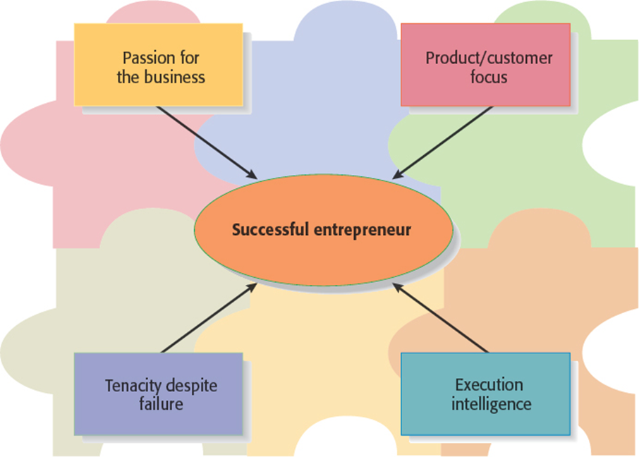
Figure 1.1 Four Primary Characteristics of Successful Entrepreneurs

Slide 13
1.3 Characteristics of Successful Entrepreneurs (2 of 2)
Tenacity Despite Failure
  Because entrepreneurs are typically trying something new, the failure rate is naturally high.
  A defining characteristic for successful entrepreneurs is their ability to persevere through setbacks and failures.
Execution Intelligence
  The ability to fashion a solid business idea into a viable business is a key characteristic of successful entrepreneurs.

Slide 14
1.4 Common Myths About Entrepreneurs (1 of 6)
Myth 1: Entrepreneurs Are Born, Not Made
  This myth is based on the mistaken belief that some people are genetically predisposed to be entrepreneurs.
  The consensus of many studies is that no one is “born” to be an entrepreneur; everyone has the potential to become one.
  Whether someone does or doesn’t become an entrepreneur is a function of their environment, life experiences, and personal choices.

Slide 15
1.4 Common Myths About Entrepreneurs (2 of 6)
Although no one is “born” to be an entrepreneur, there are common traits and characteristics of successful entrepreneurs.
A moderate risk taker
Persuasive
Promoter
Resource assembler/leverager
Creative
Self-starter
Tenacious
Tolerant of ambiguity
Visionary
Optimistic disposition
A networker
Achievement motivated
Alert to opportunities
Self-confident
Decisive
Energetic
A strong work ethic
Lengthy attention span

Slide 16
1.4 Common Myths About Entrepreneurs (3 of 6)
Myth 2: Entrepreneurs Are Gamblers
  Most entrepreneurs are moderate risk takers.
  The idea that entrepreneurs are gamblers originates from two sources:
    Entrepreneurs typically have jobs that are less structured, and so they face a more uncertain set of possibilities than people in traditional jobs.
    Many entrepreneurs have a strong need to achieve and set challenging goals, a behavior that is often equated with risk taking.

Slide 17
1.4 Common Myths About Entrepreneurs (4 of 6)
Myth 3: Entrepreneurs Are Motivated Primarily by Money
  While it is naïve to think that entrepreneurs don’t seek financial rewards, money is rarely the reason entrepreneurs start new firms.
  In fact, some entrepreneurs warn that the pursuit of money can be distracting.

Slide 18
1.4 Common Myths About Entrepreneurs (5 of 6)
Myth 4: Entrepreneurs Should Be Young and Energetic
  Entrepreneurial activity is fairly evenly spread out over age ranges.
  While it is important to be energetic, investors often cite the strength of the entrepreneur as their most important criterion in making investment decisions.
    What makes an entrepreneur “strong” in the eyes of an investor is experience, maturity, a solid reputation, and a track record of success.
    These criteria favor older rather than younger entrepreneurs.

Slide 19
Table 1.4 Age Distribution of New Entrepreneurs
Age | 1996 | 2018
20–34 | 34.3% | 25.0%
35–44 | 27.4% | 24.0%
45–54 | 23.5% | 25.3%
55–64 | 14.8% | 25.8%
Source: R. Fairlie, S. Desai, and A.J. Herrmann, “2019 National Report on Early-Stage Entrepreneurship,” Kauffman Indicators of Entrepreneurship,
https://www.indicators.kauffman.org/wp-content/uploads/sites/2/2019/09/National_Report_Sept_2019.pdf
(2019).

Slide 20
1.4 Common Myths About Entrepreneurs (6 of 6)
Myth 5: Entrepreneurs Love the Spotlight
  While some entrepreneurs are flamboyant, the vast majority of them do not attract public attention.
  As evidence of this, consider the following question: “How many entrepreneurs could you name?”
    Most of us could come up with Jeff Bezos of
    Amazon.com
    , Robert Johnson of B E T, Mark Zuckerberg
    of Facebook, or Elon Musk of Tesla, Space X, and X (formerly Twitter).
    But few could name the founders of Netflix, Spotify, Alibaba, Instagram, or Redditt, even though we frequently use those firms’ services.

Slide 21
Figure 1.2 Types of Startup Firms
Salary-Substitute Firms
Firms that basically provide their owner or owners a similar level of income to what they would be able to earn in a conventional job
Lifestyle Firms
Firms that provide their owner or owners the opportunity to pursue a particular lifestyle, and make a living at it
Entrepreneurial Firms
Firms that bring new products and services to the market by creating and seizing opportunities regardless of the resources they control currently
Notes:
As shown in Figure 1.2, there are three types of startup firms: salary-substitute firms, lifestyle firms, and entrepreneurial firms.

Slide 22
1.6 Who Is the Entrepreneur? (1 of 5)
Women Entrepreneurs
  In 2020, women accounted for 40.5 percent of new business owners.
  There are several excellent organizations promoting and supporting entrepreneurship by women. The National Association of Women Business Owners (N A W B O), with chapters throughout the United States.
  There is an increasing number of venture funds and startup accelerators for women choosing to be entrepreneurs.

Slide 23
1.6 Who Is the Entrepreneur? (2 of 5)
Entrepreneurs of Different Races/Ethnicities
  There has been a substantial increase in minority entrepreneurs in the United States.
  In 2020, new entrepreneurs were 55.6 percent White, 21.7 percent Latinx, 13.1 percent African American, and 6.7 percent Asian American.
  Organizations promoting and supporting minority entrepreneurs include the Minority Business Development Agency (M B D A), the U.S. Hispanic Chamber of Commerce, the Black Business Association, and the Asian Business Association.

Slide 24
1.6 Who Is the Entrepreneur? (3 of 5)
Foreign-Born versus U.S.-Born Entrepreneurs
  The share of foreign-born new entrepreneurs more than doubled from 1996 to 2018.
    Immigrant Learning Center data shows that 43 percent of Fortune 500 companies have founders who were either first- or second-generation immigrants, while immigrants founded 28 percent of Main Street Businesses across the United States.

Slide 25
1.6 Who Is the Entrepreneur? (4 of 5)
Gen Z Entrepreneurs
  Gen Z includes those born between 1997 and 2012.
  Gen Z has a strong desire to pursue an entrepreneurial career and a strong focus on environmental issues.
  An Ernest & Young survey shows several points of interest:
    Digital acceleration
    Intentional consumerism
    Purpose and environmental, social, & governance
    Workplace culture
Notes:
The conclusion of the EY survey is that if businesses understand Gen Z, they will understand what’s “next.” Additional findings of interest from the survey include:
■ Digital acceleration: Gen Z will be early adopters and will push new technologies further into the mainstream.
■ Intentional consumerism: Given their unprecedented access to information and the innate ability to use it, Gen Z people not only influence family purchase decisions more than youth of past generations, they also drive purchases in key categories, from automobiles to furniture and groceries. Their tendency is to flock to brands that share their values.
■ Purpose and Environmental, Social, & Governance (ESG): For the Gen Z group, sustainability is a matter of trust. Companies must consider Gen Z’s role in every part of the business—from sourcing and packaging, to operations, footprint, and investments.
■ Workplace culture: Gen Z people demonstrate a strong preference to find fulfilling careers where they are valued versus making money. They will remain loyal to companies that align with their personal values and make them feel their contributions are appreciated.

Slide 26
1.6 Who Is the Entrepreneur? (5 of 5)
There are many organizations available to help college students learn more about entrepreneurship and/or advance their business ideas.
  These include C E O (Collegiate Entrepreneurs’ Organization), CollabFinder, Dorm Room Fund, Entrepreneurs’ Organization, and VentureWell.

Slide 27
1.7 The Positive Effects of Entrepreneurship and Entrepreneurial Firms (1 of 3)
Creative Destruction
  Entrepreneurs develop new products and technologies that over time make current products and technologies obsolete.
    New products and technologies are typically better than those they replace, and the availability of improved products and technologies increases consumer demand, so creative destruction stimulates economic activity.
Notes:
Often, we label small firms practicing this art as “innovators” or “agents of change.” The process of creative destruction is not limited to new products and technologies; it can include new pricing strategies (e.g., Warby Parker in eyewear), new distribution channels (such as e-books for books), or new retail formats (such as IKEA in furniture and Whole Foods Market in groceries).

Slide 28
1.7 The Positive Effects of Entrepreneurship and Entrepreneurial Firms (2 of 3)
Innovation
  Is the process of creating something new, which is central to the entrepreneurial process.
    Small businesses that engage in R&D generate more patents per employee than larger businesses that engage in R&D.
Job Creation
  Small businesses create a substantial number of net new jobs in the United States.
    As of the first quarter of 2022, small firms had recovered almost all net jobs lost during the COVID-19 pandemic.

Slide 29
1.7 The Positive Effects of Entrepreneurship and Entrepreneurial Firms (3 of 3)
Impact on Society
  The innovations of entrepreneurial firms have a dramatic impact on society.
    Think of all the new products and services that make our lives easier, enhance our productivity at work, improve our health, and entertain us.
Impact on Larger Firms
  Many entrepreneurial firms have built their entire business models around producing products and services that help larger firms become more efficient and effective.

Slide 30
1.8 The Entrepreneurial Process
The Entrepreneurial Process Consists of Four Steps
Step 1: Decision to become an entrepreneur
Step 2: Developing successful business ideas
Step 3: Moving from an idea to an entrepreneurial firm
Step 4: Managing and growing the entrepreneurial firm

Slide 31
1.9 Developing Skills for Your Career
Business Ethics and Social Responsibility
  Understand the importance of a strong ethical culture
Critical Thinking
  Think critically about entrepreneurial success
    What Went Wrong features
Collaboration
  Collaborate to reach goals
    Partnering for Success features
Data Literacy
  Learn how to access and interpret data

Slide 32
Copyright
This work is protected by United States copyright laws and is provided solely for the use of instructors in teaching their courses and assessing student learning. Dissemination or sale of any part of this work (including on the World Wide Web) will destroy the integrity of the work and is not permitted. The work and materials from it should never be made available to students except by instructors using the accompanying text in their classes. All recipients of this work are expected to abide by these restrictions and to honor the intended pedagogical purposes and the needs of other instructors who rely on these materials.

