Slide 1
Studio television production
lectures and practice
Credit : https://en.wikipedia.org/wiki/Television_studio

Slide 2
Studio television production
Production control room
The production control room is the place in a television studio in which the composition of the outgoing program takes place. The production control room is occasionally also called a studio control room (SCR) or a "gallery" – the latter name comes from the original placement of the director on an ornately carved bridge spanning the BBC's first studio at Alexandra Palace, which was once referred to as like a minstrels' gallery.

Slide 3
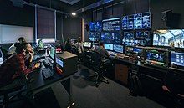
Studio television production
The vast majority of devices in a PCR are interfaces for rack-mounted equipment that is located in the Central Apparatus Room (CAR).

Slide 4
Studio television production
Central apparatus room
The central apparatus room (CAR) houses equipment that is too noisy or runs too hot to be located in the production control room (PCR). It also makes sure that coax cable, SDI cable, Fibre optic cable or other wire lengths and installation requirements keep within manageable lengths, since most high-quality wiring runs only between devices in this room. This can include the actual circuitry and connections between:

Slide 5
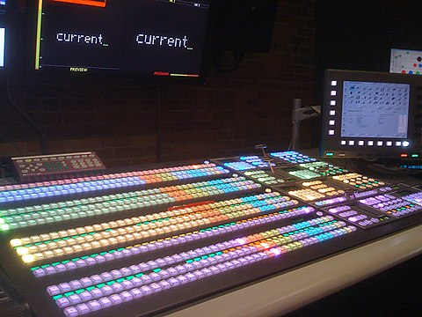
Studio television production
character generator (CG)
camera control units (CCU)
digital video effects (DVE)
video routers
video servers
vision mixer (video switcher)
VTRs
patch panels

Slide 6
Studio television production
Master control room
Master control is the technical hub of a broadcast operation common among most over-the-air television stations and television networks. Master control is distinct from a PCR in television studios where the activities such as switching from camera to camera are coordinated. A transmission control room (TCR) is usually smaller in size and is a scaled-down version of centralcasting.

Slide 7
Studio television production
The master control room in a US television station is the place where the on-air signal is controlled. It may include controls to playout pre-recorded television programs and television commercials, switch local or television network feeds, record satellite feeds and monitor the transmitter(s), or these items may be in an adjacent equipment rack room. If the program is broadcast live, the signal goes from the PCR to MCR and then out to the transmitter.

Slide 8
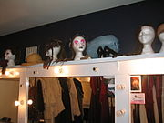
Studio television production
Other facilities
A television studio usually has other rooms with no technical requirements beyond video monitors and studio monitors for audio. Among them are

Slide 9
Studio television production
one or more make-up and changing rooms
a reception area for crew, talent, and visitors, commonly called the green room
an audience handling area

