Slide 1

Culture、Ethic and Social Responsibility
Instructor: Ms Caimei HU

Slide 2
Learning Objectives
What you should learn from Week 3:
Understanding hidden cultural layers effective global strategy.
To know trade routes and historical perspective in international trade.
Understanding history & culture in global marketing.
The important of CSR and Ethics in international business.

Slide 3
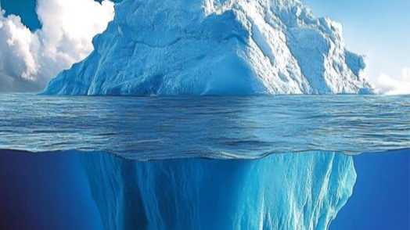
The Iceberg Model in International Marketing
Understanding Hidden Cultural Layers for Effective Global Strategy

Slide 4
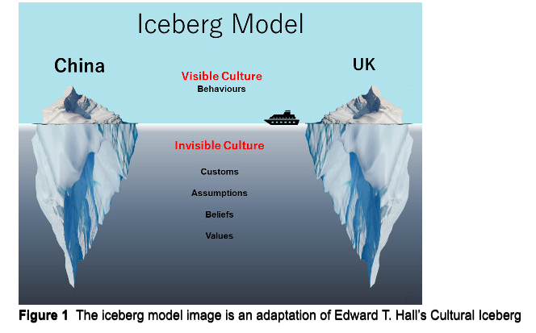
What is the Iceberg Model?
The Iceberg Model of Culture suggests that culture is like an iceberg:
- Only a small part (visible) is seen above the surface.
- A much larger part (invisible) lies beneath the surface.
This idea was popularized by anthropologist Edward T. Hall.

Slide 5
Structure of the Cultural Iceberg
Layer | Description | Marketing Implication
Visible Culture | Behaviors, dress, language, food, music | Easy to observe and imitate; often leads to superficial localization
Invisible Culture | Values, beliefs, attitudes, thought patterns, communication styles, time perception, gender roles, authority relationships | Drives actual consumer motivation, brand perception, trust, and buying behavior

Slide 6
Why It Matters in International Marketing
Misunderstanding | Example | Consequence
Interpreting only visible culture | Translating ads literally without adapting to humor, values, or taboos | Offense or confusion (e.g., Pepsi’s “Come alive” slogan in Taiwan)
Ignoring deep values | Promoting individualism in collectivist societies | Product rejection or brand mistrust
Not adapting communication styles | Using direct language in a high-context culture | Viewed as rude or inappropriate

Slide 7


Marketing Applications
Product Design
- Colors, symbols, packaging should align with deep cultural meanings (e.g., red means luck in China but danger in Western countries)
Advertising Messaging
- Humor, emotion, and tone must reflect cultural thought patterns
E.g., Thai ads tend to use indirect messaging and emotional storytelling.

Slide 8
.✅ Branding
- Brand names and slogans must reflect local values (trust, tradition, community)
E.g., Dove in Western markets = self-confidence, in Asia = fair skin & femininity.\

Slide 9
Summary
Insight | Action
Surface-level adaptation isn’t enough | Dive into deep culture to truly localize marketing
Culture affects every part of marketing | From brand tone to retail layout
Successful international marketers | Respect, research, and adapt to cultural depth

Slide 10

Cultural Iceberg of China
Layer | Elements
Visible Culture | Mandarin language, red color in festivals, dragon dance, chopsticks, traditional clothing (e.g., qipao), tea drinking, gift giving
Invisible Culture | - Respect for hierarchy and elders - Guanxi (relationship networks and obligations) - Face (mianzi): saving social reputation - Group harmony over individual expression- - Indirect communication - Long-term orientation and pragmatism - Filial piety and family loyalty - High power distance acceptance - Emphasis on education and success - Subtle emotional expression

Slide 11

Cultural Iceberg of Thailand
Students draw a cultural iceberg of their country and explain how a foreign brand could succeed or fail depending on which layer they adapt to.

Slide 12
IBB2402
Trade Routes and Historical Perspective in International Trade

Slide 13
Trade Routes
In recent years, a number of infrastructural projects have been ongoing. Two major projects stand out:
1. The European Union's Trans-European Transport Network (TEN-T): Aims to develop a Europe-wide network of roads, railways, inland waterways, maritime shipping routes, ports and airports.
2. China’s Belt and Road Initiative (BRI): Funded mainly by Chinese investments and soft loans, includes two components:
IBB2402

Slide 14
Trade Routes
• China’s Belt and Road Initiative (BRI): Funded mainly by Chinese investments and soft loans, includes two components:
- The Silk Road Economic Belt (the Belt): Connects China to Central and South Asia, and then to Europe.
- The New Maritime Silk Road (the Road): Connects China to South-east Asia, the Gulf, East and North Africa, and Europe.
IBB2402

Slide 15
Trade Routes
Today, Chinese companies control two-thirds of the world’s shipping capacity.
The scale of BRI is expanding:
• 65 countries involved in 2017
• 87 countries by the end of 2019
IBB2402

Slide 16
Trade Routes
According to WTO, a one-day shipping delay reduces global trade by at least 1%.
Improved transport infrastructure supports:
• Sustainable business growth (North-South and South-South)
• Cost reductions in trade
• Emerging markets' competitive advantage
IBB2402

Slide 17
IBB2402
Understanding History & Culture in Global Marketing

Slide 18
Historical Perspective in International Trade
Understanding a country's history helps explain national attitudes, self-image, and relationships with other countries.
It sheds light on:
• Role of government and business
• Manager-worker relationships
• Sources of management authority
• Attitudes toward foreign multinational corporations
IBB2402

Slide 19
🌏 Cultural Sensitivity & Tolerance in International Marketing
🧠 What is Cultural Sensitivity?
"Being attuned to the nuances of culture, which can then be viewed objectively, evaluated, and appreciated."
Recognizing differences, not judging them
Cultures are not better or worse, only different
💬 Examples of Cultural Differences
Some Westerners may find it odd that Chinese eat dogs
Some Chinese find it strange that Westerners eat rabbits, lambs, but not dogs or cats
➡️ Different perceptions ≠ wrong perceptions
🤝 Key Principles for Marketers
IBB2402

Slide 20
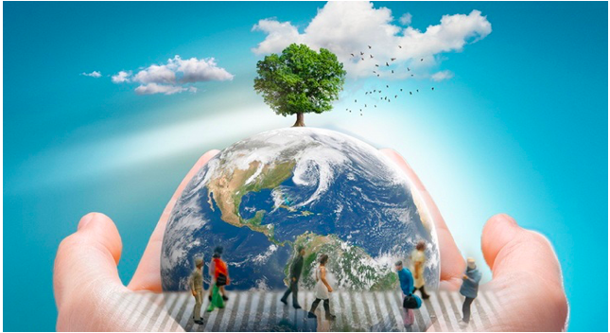
IBB2402
Social Responsibility and Environmental Management

Slide 21
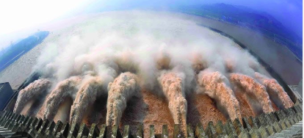
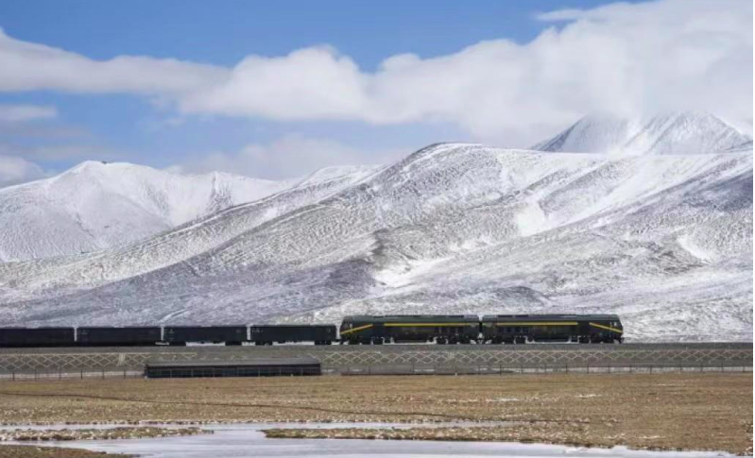
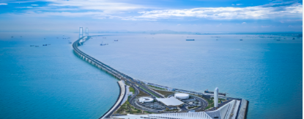

Nature environment and international trade
🌍 Geographical Challenges and Economic Development
🏗️ Overcoming Natural Barriers
Economic growth drives infrastructural development:
Tunnels, bridges, dams constructed
IBB2402

Slide 22
Nature environment and international trade
🌱 Success & Limitations
Developed countries:
✅ Effective in minimizing effects of geography
✅ Consistent economic growth
Developing countries:
⚠️ Struggle with geographical and environmental challenges
⚠️ Despite high potential for economic growth
IBB2402

Slide 23
🌪️ Environmental & Human Challenges in Developing Countries
⚠️ Fragile Balance: Subsistence vs. Disaster
Many developing countries live on the edge of survival
Vulnerable to natural and human-made catastrophes
Key Contributing Factors
Climate & Topography
Civil Wars & Poor Governance Ineffective Environmental Policies
Natural Disasters (e.g., droughts, floods)
IBB2402

Slide 24
🌪️ Environmental & Human Challenges in Developing Countries
💧 Agricultural & Land Issues
Lack of irrigation and water management Soil erosion, creeping deserts
Deforestation, overgrazing
👨‍👩‍👧‍👦 Social Impact
Rising population worsens environmental strain;Leads to malnutrition, poor health
Further reduces problem-solving capacity
IBB2402

Slide 25
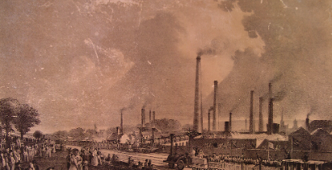
1. Environmental Focus in the 21st Century
- The 21st century is recognized as the century of the environment.
- Environmental protection is no longer optional—it's an essential business process.
- Global consensus is forming among nations, businesses, and individuals.
- Focus is shifting from national to global environmental threats.
IBB2402

Slide 26

2. Global Activism and Government Action
- Green activists and NGOs are pushing for environmental responsibility.
- Asian governments are tightening regulations and improving enforcement.
- Pollution control is becoming a top priority worldwide.
- Key motivator: Pollution is nearing uncontrollable levels.
IBB2402

Slide 27
Environmental and Geographic Impact on Marketing
- Climate conditions can damage products (e.g., Rolls-Royce in Canada)
- Salted roads corrode vehicles; oil system leaks
- Highlights the need to adapt product design to local environments

Slide 28
Growing Awareness and Responsibility
- Influential bodies like OECD, UN, and the EU lead environmental efforts.
- Business and public awareness is increasing.
- Environmental protection is now seen as a moral and social responsibility.
- Everyone has a role—not just governments or businesses.
IBB2402

Slide 29
International Agreements and Challenges
- Kyoto Protocol signed by the EU, Russia, and others.
- Goal: Reduce pollution levels over the coming years.
- USA refused to sign or ratify the agreement.
- Urban areas (e.g., Los Angeles, Rome, Mexico City) suffer major air pollution.
IBB2402

Slide 30
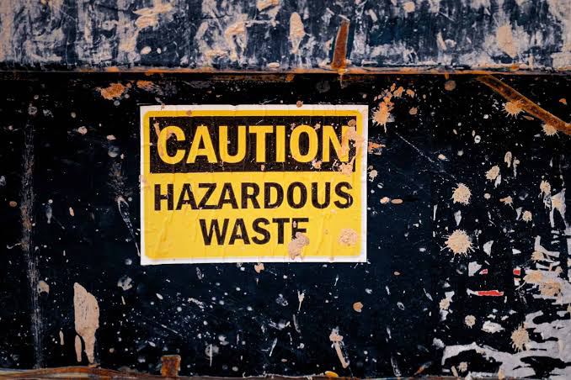
The Hazardous Waste Dilemma
- Industrial waste control produces hazardous by-products.
- Over 300 million tonnes of hazardous waste produced annually.
- Key concern: How to dispose of it responsibly without shifting the problem.
IBB2402

Slide 31
Sustainable Development – The Way Forward
- Can economic growth and trade coexist with environmental protection?
- Solution: Sustainable development—balancing
• Trade
• Environment
• Technology
• Society
- More companies now realize: What’s good for the planet is good for business.
IBB2402

Slide 32
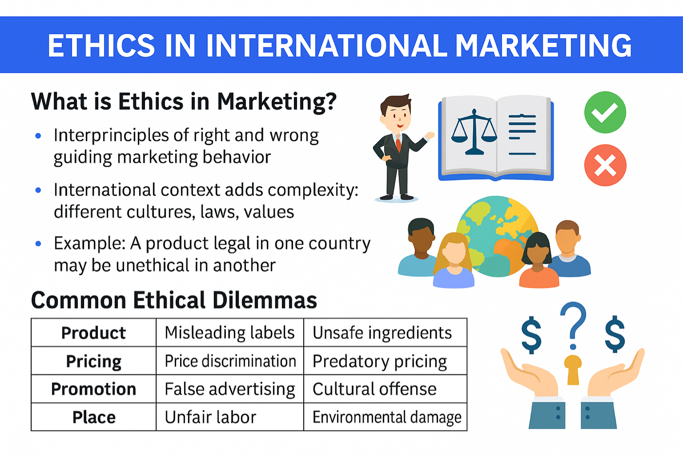
IBB2402

Slide 33
How to Promote Ethics in International Marketing？
Conduct cultural research
Train staff in ethical decision-making
Build global codes of conduct
Be transparent with stakeholders
IBB2402

Slide 34
Wrap-Up & Discussion
🧠 Final Questions:
Can marketing ever be truly ethical and profitable?
Should companies follow local ethics or global values?
How can ethics be a competitive advantage?
IBB2402

Slide 35
THANKS

