Slide 1
Operating and Financial Leverage
Lesson 12

Slide 2
Objectives
Define operating and financial leverage and identify causes of both.
Calculate a firm’s operating break-even (quantity) point and break-even (sales) point.
Define, calculate, and interpret a firm’s degree of operating, financial, and total leverage.
Understand EBIT-EPS break-even, or indifference, analysis, and construct and interpret an EBIT-EPS chart.
Define, discuss, and quantify “total firm risk” and its two components, “business risk” and “financial risk.”
Understand what is involved in determining the appropriate amount of financial leverage for a firm.

Slide 3
Leverage The use of fixed costs in an attempt to increase (or lever up) profitability.
Operating leverage The use of fixed operating costs by the firm. Financial leverage The use of fixed financing costs by the firm.
The British expression is gearing

Slide 4
Operating Leverage
Operating leverage is present any time a firm has fixed operating costs – regardless of volume. In the long run, of course, all costs are variable. Consequently, our analysis necessarily involves the short run

Slide 5
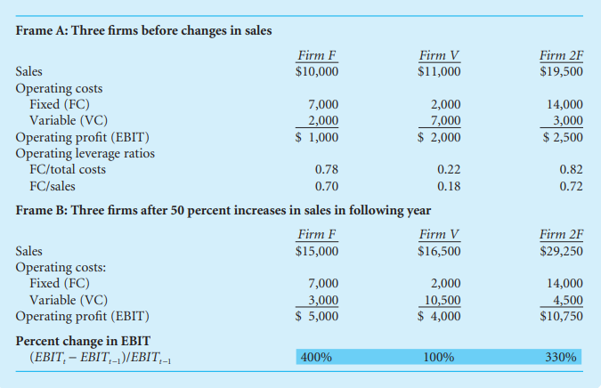

Slide 6
Break-Even Analysis
Break-even analysis A technique for studying the relationship among fixed costs, variable costs, sales volume, and profits. It is also called cost/volume/profit (C/V/P) analysis.
Break-even chart A graphic representation of the relationship between total revenues and total costs for various levels of production and sales, indicating areas of profit and loss.
Break-even point The sales volume required so that total revenues and total costs are equal; may be expressed in units or in sales dollars.

Slide 7
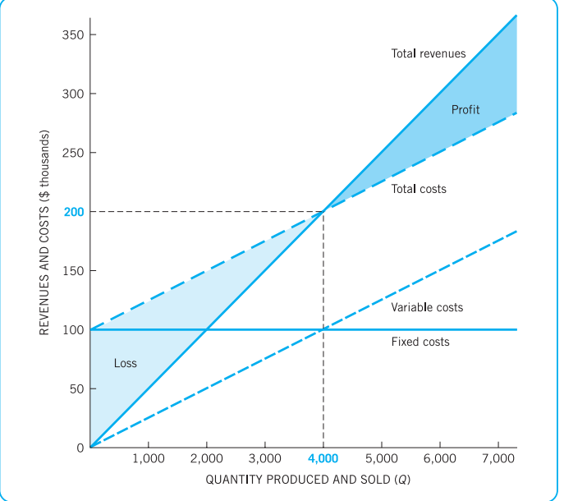

Slide 8
EBIT = P(Q) − V(Q) − FC = Q(P − V) − FC
where EBIT = earnings before interest and taxes (operating profit)
P = price per unit
V = variable costs per unit
(P − V) = unit contribution margin
Q = quantity (units) produced and sold
FC = fixed costs At the break-even point (QBE), EBIT is zero.
Therefore, 0 = QBE(P − V) − FC (16.2) Rearranging Eq.
the break-even point is QBE = FC/(P − V )

Slide 9
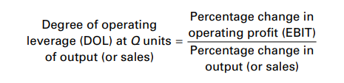
Degree of Operating Leverage (DOL)
Degree of operating leverage (DOL) The percentage change in a firm’s operating profit (EBIT) resulting from a 1 percent change in output (sales)

Slide 10
formula

Slide 11

Cash-Flow Ability to Service Debt
Debt capacity The maximum amount of debt (and other fixed charge financing) that a firm can adequately service.
Coverage ratios Ratios that relate the financial charges of a firm to its ability to service, or cover, them.
Interest coverage ratio Earnings before interest and taxes divided by interest charges. It indicates a firm’s ability to cover interest charges. It is also called times interest earned
. Debt-service burden Cash required during a specific period, usually a year, to meet interest expenses and principal payments. Also called simply debt service.

Slide 12
Questions
1. Define operating leverage and the degree of operating leverage (DOL). How are the two related?
2. Classify the following short-run manufacturing costs as either typically fixed or typically variable. Which costs are variable at management’s discretion? Are any of these costs fixed in the long run?
a. Insurance b. R&D g. Depletion c. Direct labor d. Advertising
e. Depreciation f. Bad-debt loss g. Raw materials h. Maintenance
3. What would be the effect on the firm’s operating break-even point of the following individual changes?
a. An increase in selling price
b. An increase in the minimum wage paid to the firm’s employees
c. A change from straight-line to accelerated depreciation d. Increased sales e. A liberalized credit policy to customer

