Slide 1


Unemployment

Slide 2
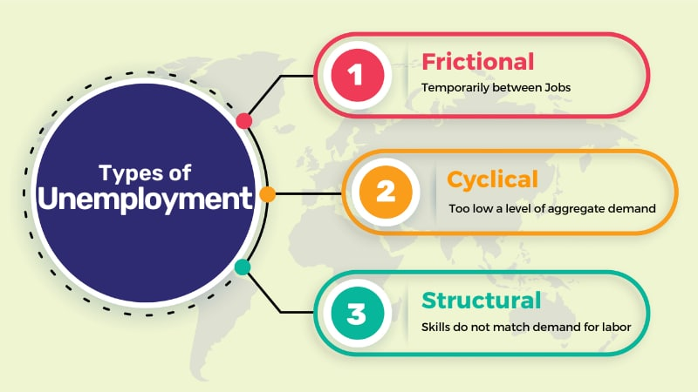
https://www.typesof.net/

Slide 3
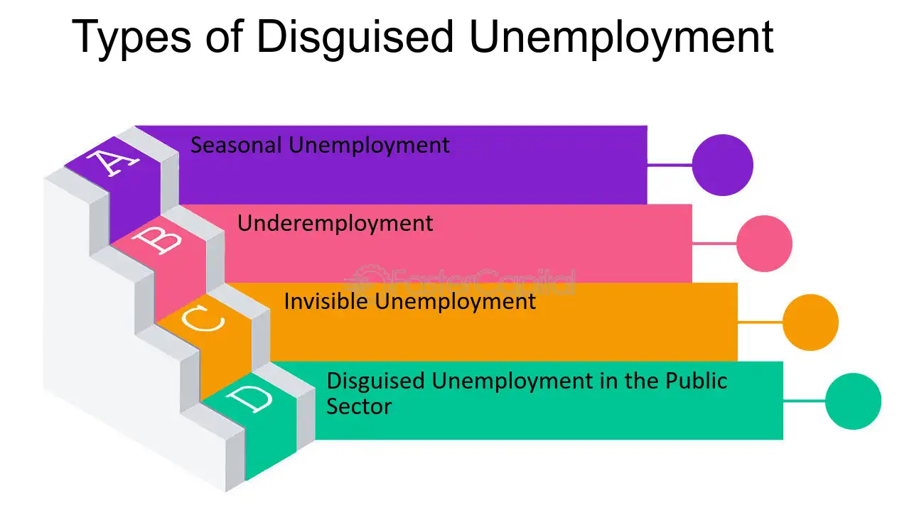
https://fastercapital.com/

Slide 4

https://www.weforum.org/

Slide 5
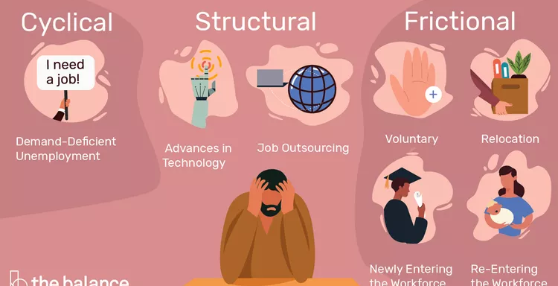
https://www.thebalancemoney.com/

Slide 6

What solutions are you going to find if you are now without a job?
Think-Pair-Share
1. THINK to yourselves (2 minutes)
2. Discuss your response with a person
sitting near you (Pair) (5 minutes)
3. SHARE out what you discussed
with your group to the entire class. (15 minutes)
4. Continue discussion (10 minutes)

Slide 7
High performance workforce
A high performing workforce is the one that is collectively better than the average workforce. It consists of employees that are smarter, well- equipped, more creative, engaged and insightful. These employees fit into the organization's culture effortlessly.

Slide 8
Challenge of High-performance Workforce Education
Others
Studying without considering labor market demands
Education is falling
behind labor market needs.
Graduates lack
job-relevant skills.
Graduates are underemployed and unemployed
Quality of higher education varies.
Over Qualification of Graduates

Slide 9
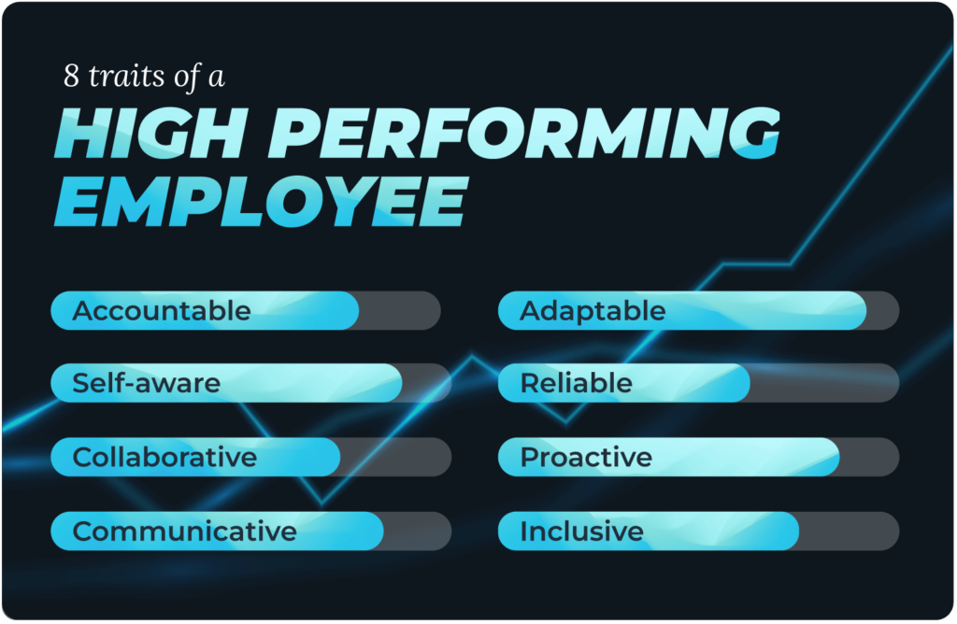
https://arbinger.com/

Slide 10
Graduates High Performance workforce, Thailand
Common skills
Specific skills
Soft skills
https://www.onec.go.th/

Slide 11
King Mongkut's University of Technology North Bangkok -Thailand
Electronic industry
Micro electronic
Print Circuit Board : PCB
Present Future
Training
Reskill
Upskill
Starting in 2018
Three generations completed Entering the industry,
50 people per program
มติชน 7 กันยายน 2567

Slide 12
South Korea high performance development workforce policy
Cultivate of future talent with creative education
Learning innovation to foster all as future talent
Enhance the independence of higher education to become a center of innovation
Narrowing educational gaps by providing lifelong learning opportunities

Slide 13
CSFs 0f development high performance workforce
Collaborate with business
and industry on learning
management
Incorporate key
capabilities into
learning
Establish a regional cooperation coordination unit
Establish clear educational goals and policies
Fostering understanding of professional competence among stakeholders
https://www.onec.go.th/

