Slide 1
Chapter 3: The Time Value of Money

Slide 2
Definition of Time Value of Money
The Importance of Time Value of Money
Future Value
Present Value

Slide 3
Definition of Time Value of Money
The time value of money (TVM) is the concept that a sum of money is worth more now than same sum will be at a future date due to its earnings potential in the interim. The time value of money is a core principle of finance. A sum of money in the hand has greater value than the same sum to be paid in the future. The time value of money is also referred to as the present discounted value.

Slide 4
The Importance of Time Value of Money
Investment decision
Future Expected return

Slide 5
Future Value
Future value (FV) is the value of a current asset at a future date based on an assumed rate of growth. The future value is important to investors and financial planners, as they use it estimate how much an investment made today will be worth in the future.

Slide 6
Future Value of a Single Amount
Suppose you invest $100 at 5% interest, compounded annually. At the end of one year, your investment would be worth:
$100 + .05($100) = $105
or
$100(1 + .05) = $105
During the second year, you would earn interest on $105. At the end of two years, your investment would be worth:
$105(1 + .05) = $110.25

Slide 7
Future Value of a Single Amount (cont.)
In General Terms: FV₁ = PV(1 + i)
and
FV₂ = FV₁(1 + i)
Substituting PV(1 + i) in the first equation for FV₁ in the second equation:
FV₂ = PV(1 + i)(1 + i) = PV(1 + i)²
For (n) Periods: FV_{n} = PV(1 + i)^{n}
Note: (1 + i)^{n} is the Future Value of $1 interest factor.
Example: Invest $1,000 @ 7% for 18 years:
FV₁₈ = $1,000(1.07)¹⁸ = $1,000(3.380) = $3,380

Slide 8
Future Value of a Single Amount (Spreadsheet Example)
FV(rate,nper,pmt,pv,type)
fv is the future value
Rate is the interest rate per period
Nper is the total number of periods
Pmt is the annuity amount
pv is the present value
Type is 0 if cash flows occur at the end of the period
Type is 1 if cash flows occur at the beginning of the period
Example: = fv(7%,18,0,-1000,0) is equal to $3,379.93

Slide 9
Interest Rate, Time, and Future Value
Future Value of $100

Slide 10
Future Value of an Annuity
Ordinary Annuity: A series of consecutive payments or receipts of equal amount at the end of each period for a specified number of periods.
Example: Suppose you invest $100 at the end of each year for the next 3 years and earn 8% per year on your investments. How much would you be worth at the end of the 3rd year?

Slide 11
Future Value of an Annuity (cont.)
T₁ T₂ T₃
$100 $100 $100
Compounds for 0 year:
$100(1.08)⁰ = $100.00
Compounds for 1 year:
$100(1.08)¹ = $108.00
Compounds for 2 year:
$100(1.08)² = $116.64
______
Future Value of the Annuity $324.64

Slide 12
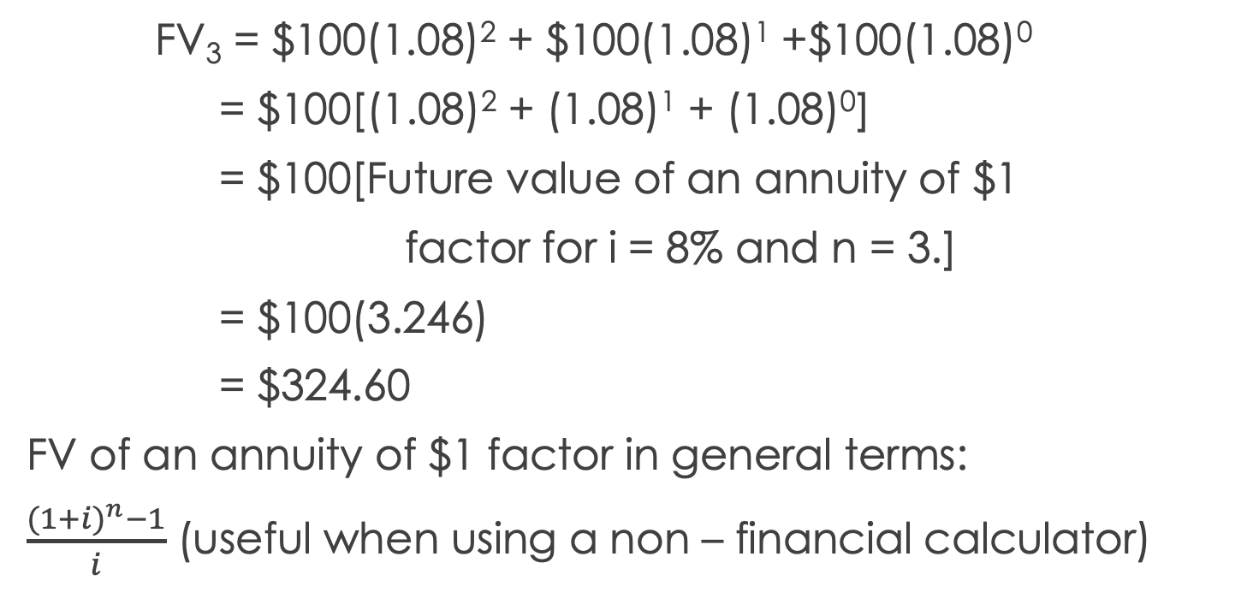
Future Value of an Annuity (cont.)
FV₃ = $100(1.08)² + $100(1.08)¹ +$100(1.08)⁰
= $100[(1.08)² + (1.08)¹ + (1.08)⁰]
= $100[Future value of an annuity of $1
factor for i = 8% and n = 3.]
= $100(3.246)
= $324.60
FV of an annuity of $1 factor in general terms:
$\frac{{(1+i)}^{n}−1}{i}$ (useful when using a non – financial calculator)

Slide 13
Future Value of an Annuity (Example)
If you invest $1,000 at the end of each year for the next 12 years and earn 14% per year, how much would you have at the end of 12 years?
FV₁₂ = $1000(27.271) given i =14% and n = 12
= $27,271

Slide 14
Future Value of an Annuity (Spreadsheet Example)
FV(rate,nper,pmt,pv,type)
fv is the future value
Rate is the interest rate per period
Nper is the total number of periods
Pmt is the annuity amount
pv is the present value
Type is 0 if cash flows occur at the end of the period
Type is 1 if cash flows occur at the beginning of the period
Example: =fv(14%,12,-1000,0,0) is equal to $27,270.75

Slide 15
Present Value
Present value (PV) is the current value of a future sum of money or stream of cash flows given a specified rate of return. Future cash flows are discounted at the discount rate, and the higher the discount rate, the lower the present value of the future cash flows. Determining the appropriate discount is the key to properly valuing future cash flows, whether they be earnings or debt obligations.

Slide 16
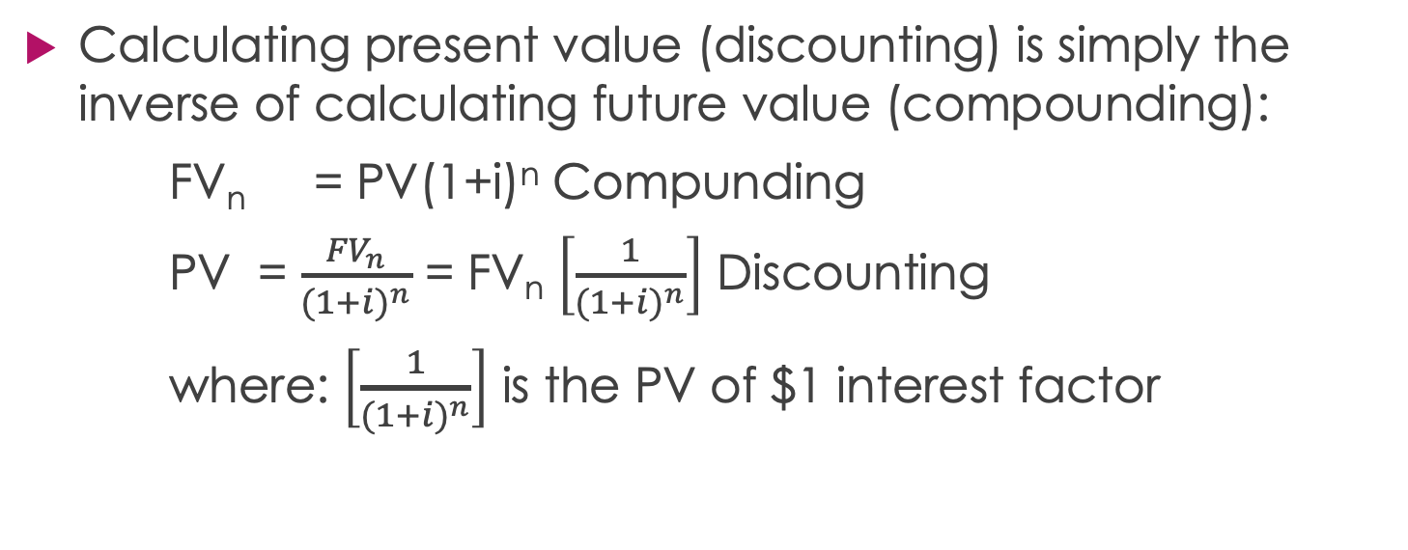
Present Value of a Single Amount
Calculating present value (discounting) is simply the inverse of calculating future value (compounding):
FV_{n} = PV(1+i)^{n} Compunding
PV = $\frac{{FV}_{n}}{{(1+i)}^{n}}$ = FV_{n} $\left[\frac{1}{{(1+i)}^{n}}\right]$ Discounting
where: $\left[\frac{1}{{(1+i)}^{n}}\right]$ is the PV of $1 interest factor

Slide 17
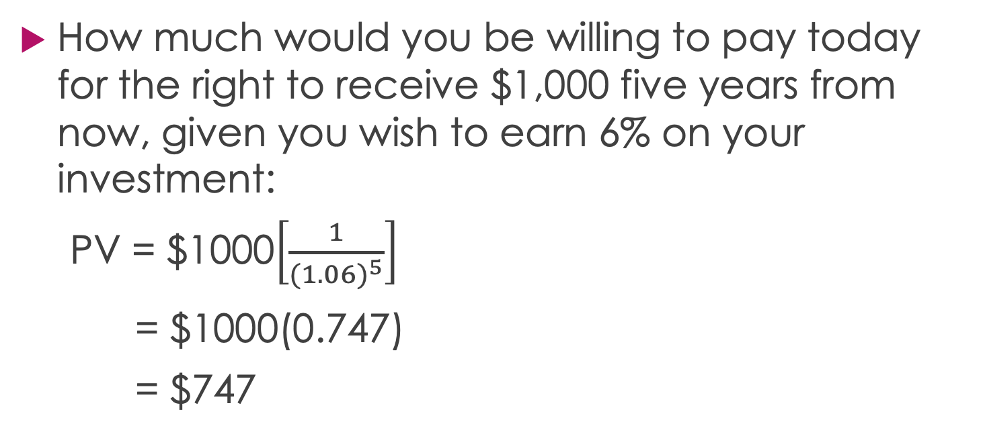
Present Value of a Single Amount (An Example)
How much would you be willing to pay today for the right to receive $1,000 five years from now, given you wish to earn 6% on your investment:
PV = $1000$\left[\frac{1}{{(1.06)}^{5}}\right]$
= $1000(0.747)
= $747

Slide 18
Present Value of a Single Amount (Spreadsheet Example)
PV(rate,nper,pmt,fv,type)
pv is the present value
Rate is the interest rate per period
Nper is the total number of periods
Pmt is the annuity amount
fv is the future value
Type is 0 if cash flows occur at the end of the period
Type is 1 if cash flows occur at the beginning of the period
Example: =pv(6%,5,0,1000,0) is equal to -$747.26

Slide 19
Interest Rate, Time, and Present Value (PV of $100 to be received in 16 years)
Present Value of $100

Slide 20
Present Value of an Annuity
Suppose you can invest in a project that will return $100 at the end of each year for the next 3 years. How much should you be willing to invest today, given you wish to earn an 8% annual rate of return on your investment?

Slide 21
Present Value of an Annuity (cont.)
T₀ T₁ T₂ T₃
$100 $100 $100
Discounted back 1 year:
$100[1/(1.08)¹] = $92.59
Discounted back 2 years:
$100[1/(1.08)²] = $85.73
Discounted back 3 years:
$100[1/(1.08)³] = $79.38
PV of the Annuity = $257.70

Slide 22
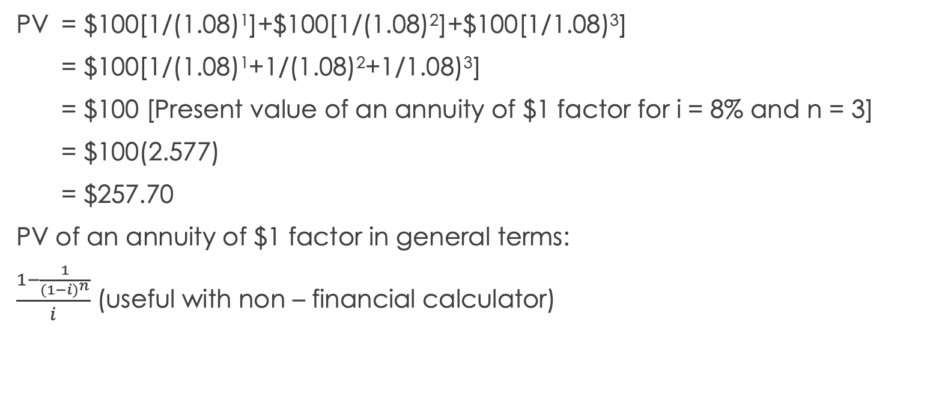
Present Value of an Annuity (cont.)
PV = $100[1/(1.08)¹]+$100[1/(1.08)²]+$100[1/1.08)³]
= $100[1/(1.08)¹+1/(1.08)²+1/1.08)³]
= $100 [Present value of an annuity of $1 factor for i = 8% and n = 3]
= $100(2.577)
= $257.70
PV of an annuity of $1 factor in general terms:
$\frac{1−\frac{1}{{(1−i)}^{n}}}{i}$ (useful with non – financial calculator)

Slide 23
Present Value of an Annuity (An Example)
Suppose you won a state lottery in the amount of $10,000,000 to be paid in 20 equal annual payments commencing at the end of next year. What is the present value (ignoring taxes) of this annuity if the discount rate is 9%?
PV = $500,000(9.129) given I = 9% and n = 20
= $4,564,500

Slide 24
Present Value of an Annuity (Spreadsheet Example)
PV(rate,nper,pmt,fv,type)
pv is the present value
Rate is the interest rate per period
Nper is the total number of periods
Pmt is the annuity amount
fv is the future value
Type is 0 if cash flows occur at the end of the period
Type is 1 if cash flows occur at the beginning of the period
Example: =pv(9%,20,-500000,0,0) is equal to $4,564,272.83

Slide 25
Summary of Compounding and Discounting Equations
In each of the equations above:
Future Value of a Single Amount
Future Value of an Annuity
Present Value of a Single Amount
Present Value of an Annuity
there are four variables (interest rate, number of periods, and two cash flow amounts). Given any three of these variables, you can solve for the fourth.

