Slide 1

Faculty of Education
SUAN SUNANDHA RAJABHAT UNIVERSITY
Building Resilience
in Preschoolers
THITIKAN THITISOPHONSAK
Instructor of Early Childhood Education
Notes:
On behalf of Early Childhood Education program. I would like to welcome you here today. My name is THITIKAN THITISOPHONSAK and I am an Instructor of Early Childhood Education program, Faculty of Education, SUAN SUNANDHA RAJABHAT UNIVERSITY. Are you looking for ways to help your child become more confident? Handle everyday frustrations better? Bounce back from life’s challenges? This presentation offers tips and resources to build your child’s resilience.

Slide 2

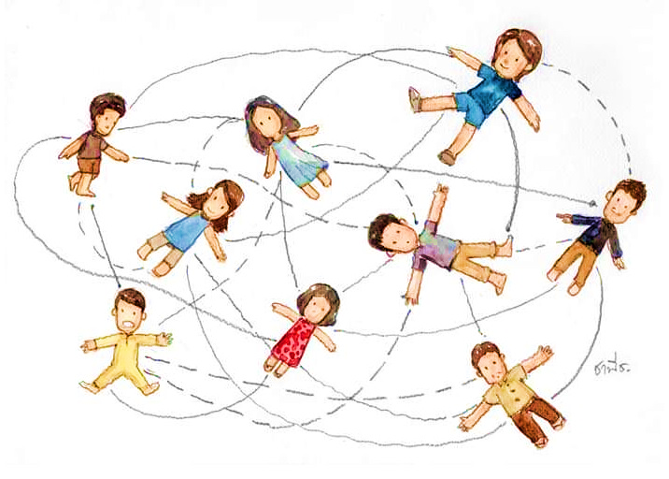
Faculty of Education
SUAN SUNANDHA RAJABHAT UNIVERSITY
Sudden changes
Serious challenges
Relationship difficulties
What is resilience?
Stressful situation
Unsafe neighborhoods
Discrimination
Hectic schedules
Feeling of isolation
Notes:
Now let me focus on… What is resilience?
Life can be challenging and may include many stressful situations. Children can feel overwhelmed by different things at different times like: Relationship difficulties, Sudden changes, Serious challenges, Unsafe neighborhoods, Hectic schedules, Feeling of isolation and Discrimination.
,

Slide 3

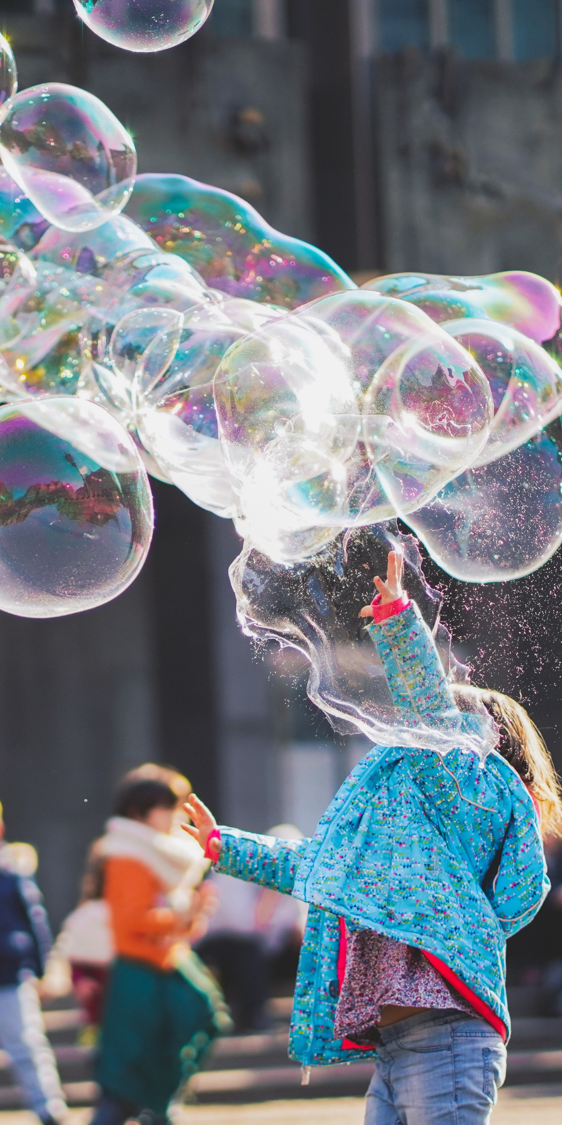
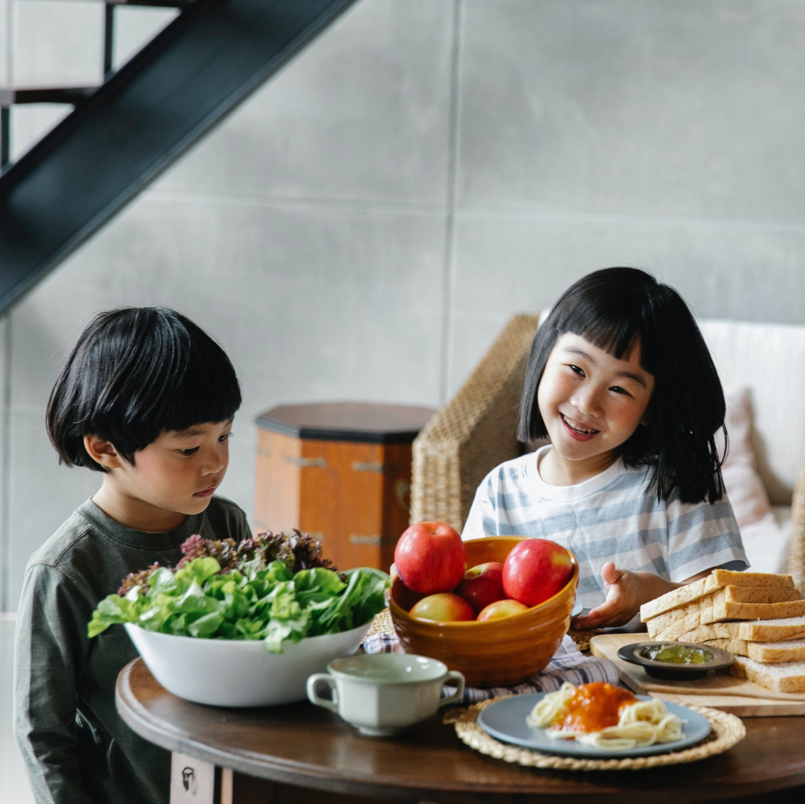
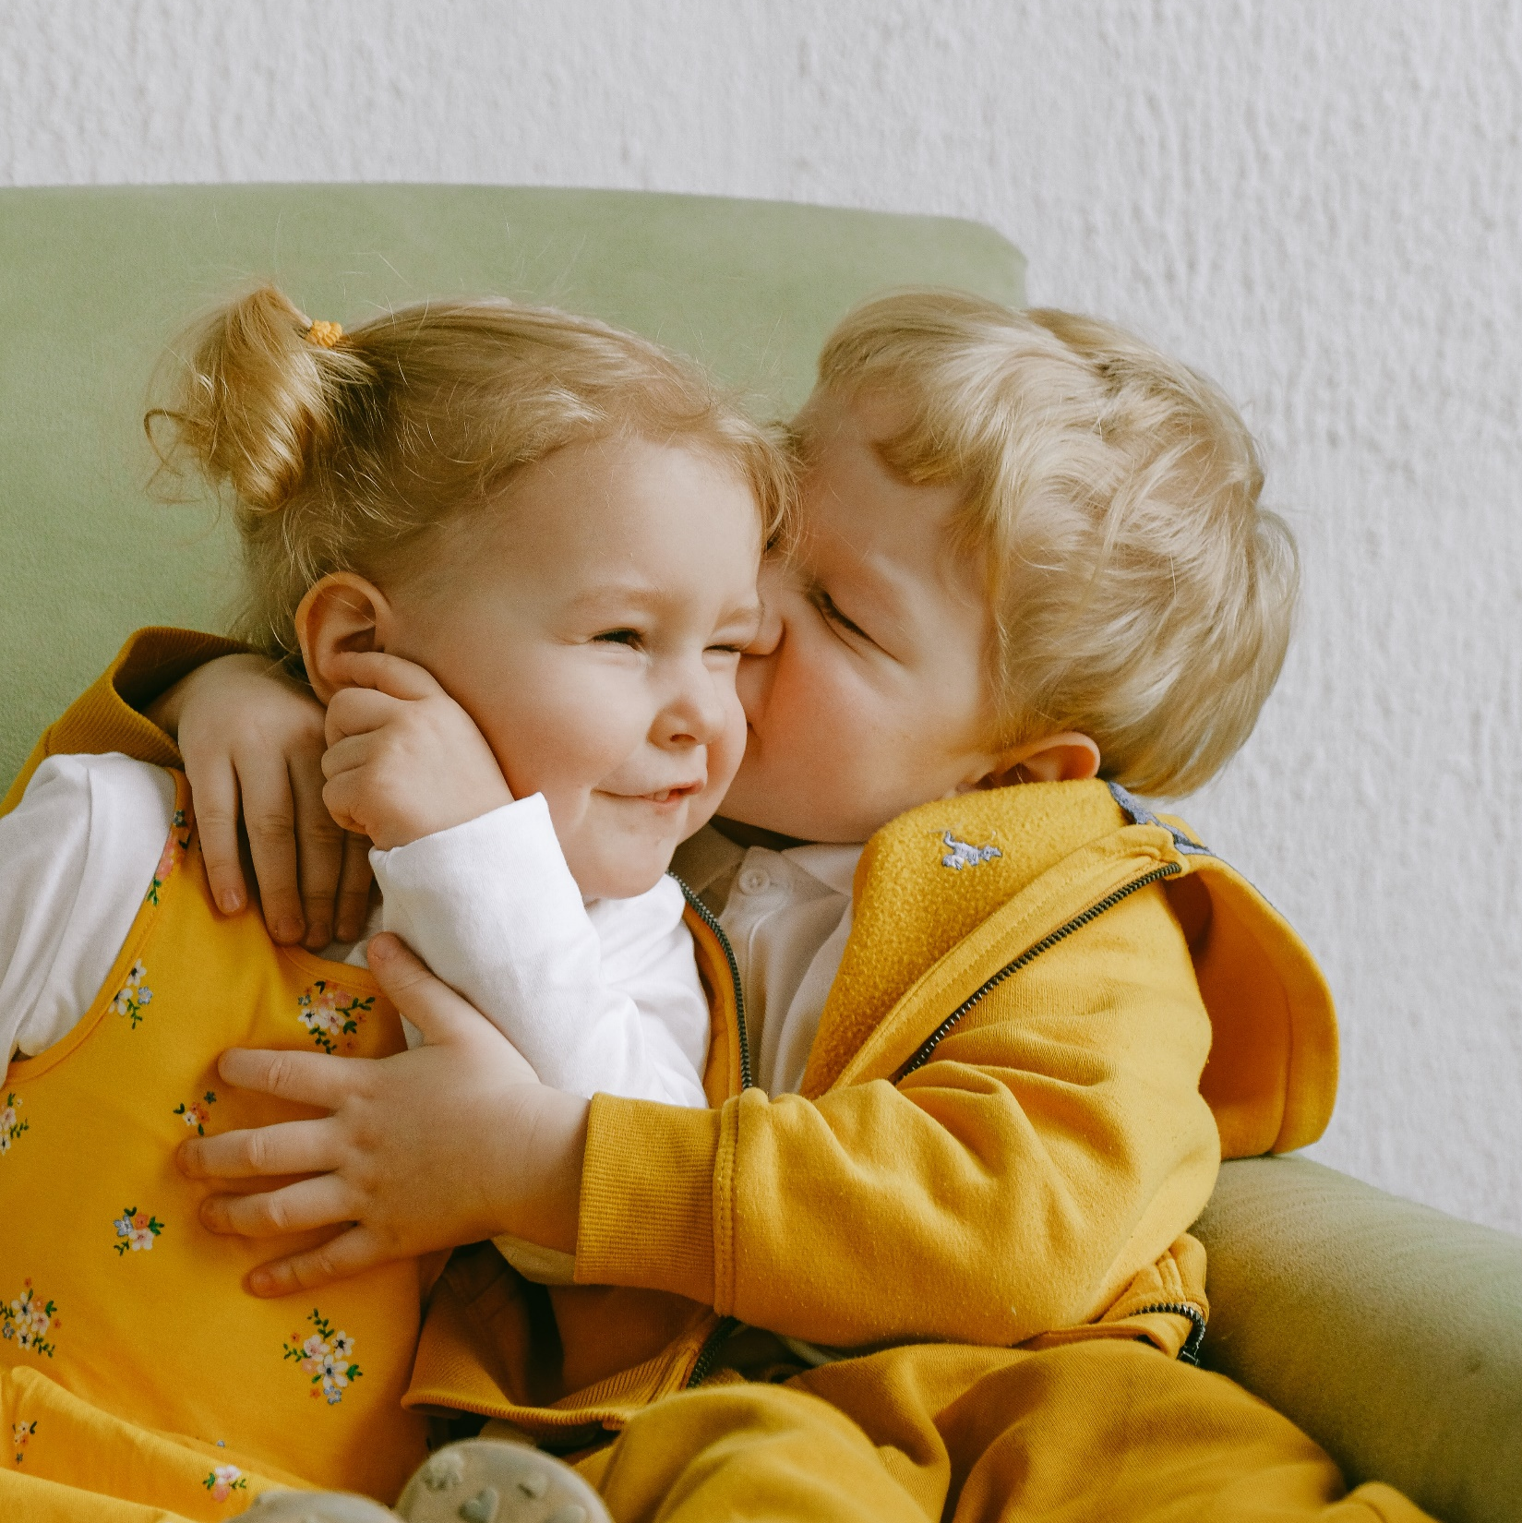
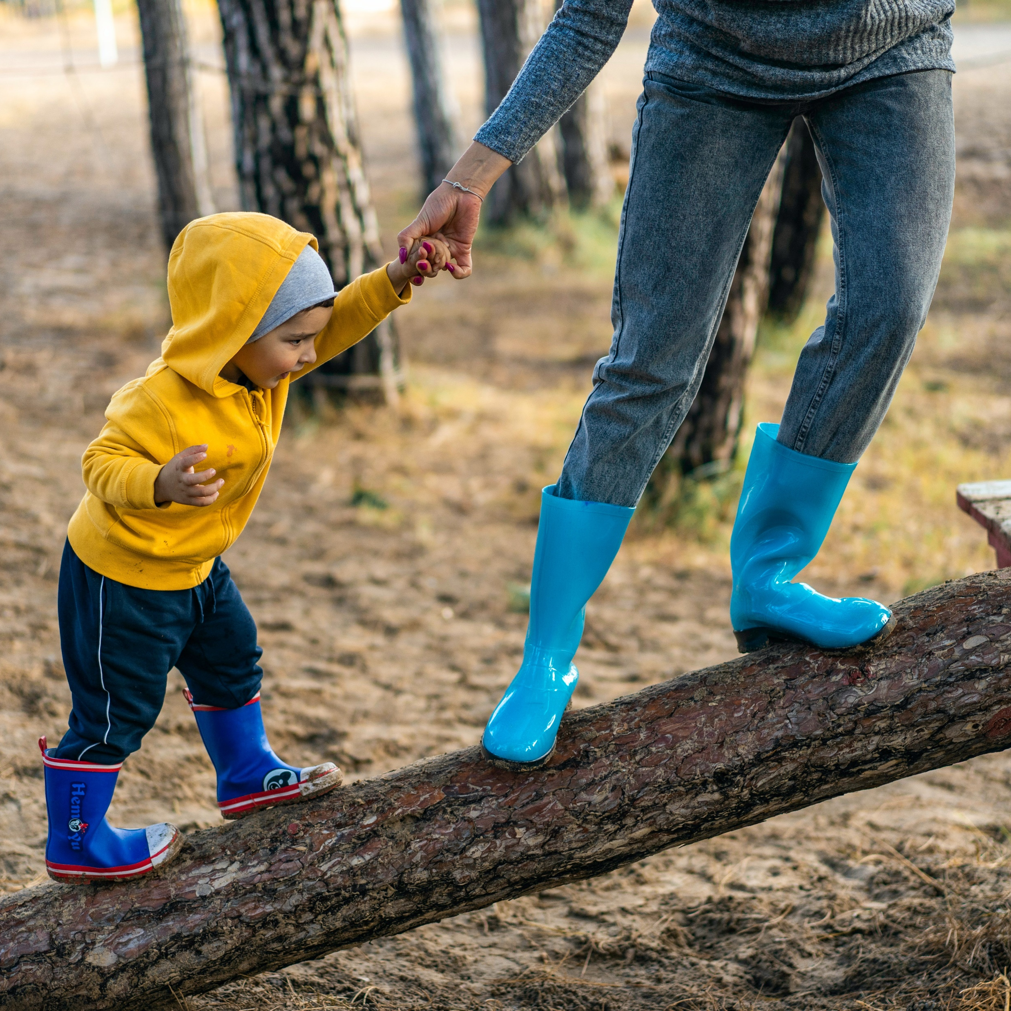
Resilience is the ability to steer through serious life challenges and find ways to bounce back and thrive.
Best start: Ontario’s Maternal, Newborn and Early child Development Resource Center
Notes:
Resilience is the ability to steer through serious life challenges and find ways to bounce back and thrive.
We are born with the capacity for resilience. But resilience is not something we have or don’t have. We work on it throughout our lives. And we need to start as early as possible. Parents and teachers are the most important people to help build their children’s resilience.
Children learn a lot by watching their parents and teachers. When parents and teachers cope well with everyday stress, they are showing their children how to do the same.

Slide 4
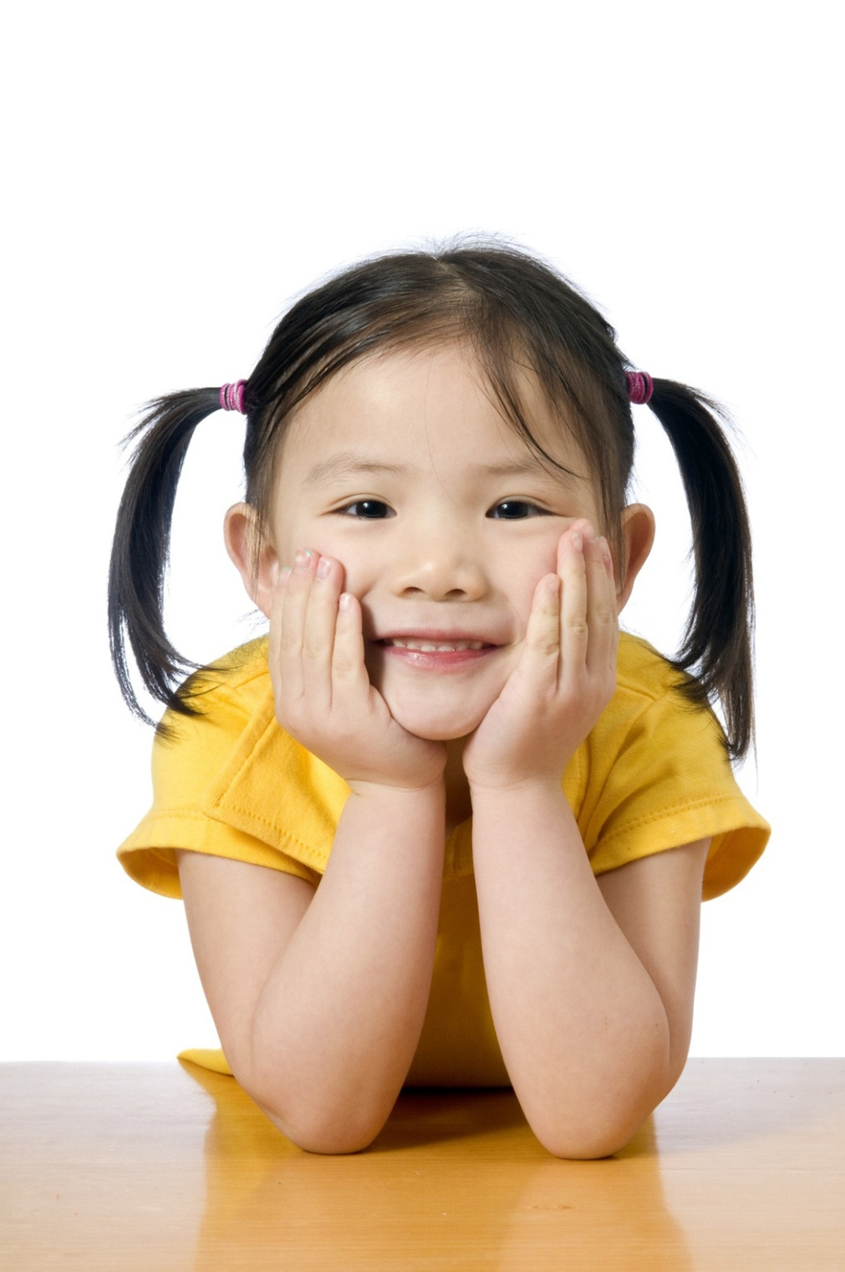
Why is it important to
develop resilience?
Happier in their relationships
More successful in school and work
Less likely to get depressed
Healthier and live longer
Notes:
In this part, I will present…Why is it important to develop resilience?
Resilience makes a big difference in people’s lives. People who respond to hardships with resilience are:
- Healthier and live longer
- Happier in their relationships
- More successful in school and work
- Less likely to get depressed

Slide 5
Resilient children often demonstrate:
A
A Sense of Autonomy
Problem-Solving Skills
Social Competency
A Sense of Purpose and Future
Notes:
Let’s consider about Resilient children often demonstrate:
A Sense of Autonomy: Resilient children have a sense of personal power, independence, and increased self-esteem (when compared to other at-risk peers). Positive emotions, such as love and gratitude, increase resilience because they serve as a buffer against depression and other negative reactions.
Problem-Solving Skills: Resilient children possess a greater ability to be flexible, reflective, and think creatively, allowing them to find alternative solutions to cognitive and life problems.
Social Competency: Resilient children exhibit a high level of interpersonal skills including: qualities of caring and empathy for others; strong communication skills, especially a sense of humour; the ability to foster positive relationships, particularly with caring adults who mentor them, treat them fairly, listen to them, and do not judge them.
A Sense of Purpose and Future: Resilient children are often realistic, goal-oriented, and set optimistic expectations regarding their future; through their past successes, they perceive themselves as competent in academics, athletics, the arts, or in other areas.

Slide 6
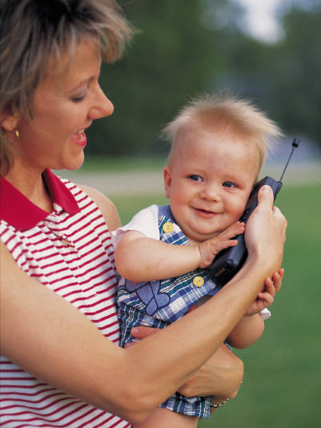
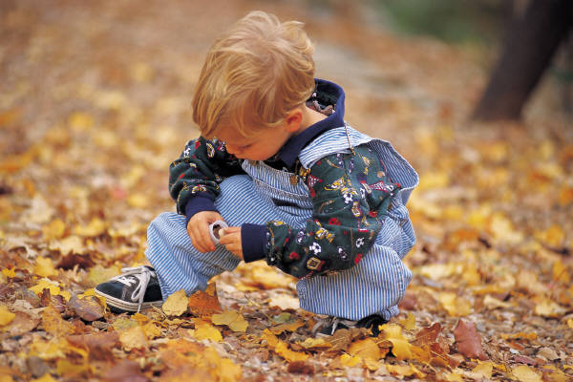
How to help your child develop strengths and gather support to build resilience.
Next section
Notes:
In the next section, you will learn how to help your child develop strengths and gather support to build resilience. Thank you for your attention.

Slide 7
THANK YOU
Insert the Subtitle of Your Presentation

