Slide 1
Introduction
The Selection of Okra Suppliers for Export to Japan by Applied an
Analytical hierarchy Process Technique
a Case Study: ABC Company, Photharam, Ratchaburi Province.

Slide 2
Introduction
This research aimed to study causes of study the solutions of supply chain in okra business for export to Japan, case study of ABC Copany, Photharam District, Ratchaburi Province in order to study all of factors that affect to select okra for export to Japan of from Ratchaburi Province. And then selected the district area of okra growers qualified for export to Japan, a case study of ABC Company, Photharam District, Ratchaburi Province

Slide 3
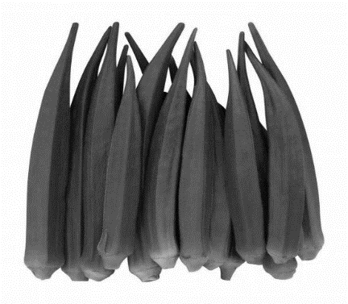
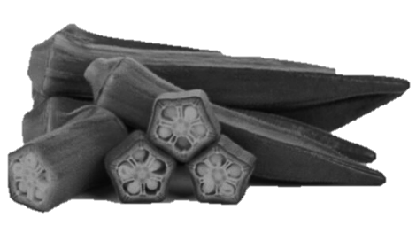
Okra is a native plant of Thailand that is easy to grow throughout the year. It is also one of the most important export vegetables in Thailand as it is a nutritious vegetable that is widely popular in many countries. Japanese people are very fond of consuming okra because of its medicinal value. Statistical data on okra exports collected by the One Stop Export Service Center found that Japan is a country that imports okra up to 8,974 tons per year, worth 302 million baht.

Slide 4
From the research, it was found that the factors for selecting okra for exporting to Japan consisting of 5 factors:
1. A pod must length around 8-11.5 cm.
2. A pod straight, have not bent and look abnormal.
3. A pod must be fresh green.
4. A pod must be pentagonal
5. A pod without of defects that caused of diseases and insects.

Slide 5
METHODS
Step 1 Organize the hierarchy to solve decision-making problems
Step 2: Fill in the input data in the Pairwise Comparison Matrix to find the comparison weight between criteria.
Step 3 Estimating the weight using the Geometric Mean method.
Step 4. Configure the overall weights of the decision components.
Step 5 Checking data consistency (Consistency) in finding the consistency of the data. If the obtained CR value is greater than 0.1, then the obtained data is invalid. If the CR value is less than 0.1, then the data is correct. The consistency ratio can be obtained from the following equation:
where CR = the corresponding proportional value
CI = Conformity Index
RI = sampling index
The Conformity Index (CI) can be obtained from
where n = size of the threshold number
and random index (Random Index, RI).

Slide 6
Table 1 Table of the priority of the factors.
Normalize and Eigenvector | A POD MUST BE FRESH GREEN. | A POD MUST BE PENTAGONAL | A POD MUST LENGTH AROUND 8-11.5 CM. | A POD STRAIGHT, HAVE NOT BENT AND LOOK ABNORMAL. | A POD WITHOUT OF DEFECTS THAT CAUSED OF DISEASES AND INSECTS. |  | Eigenvector
A POD MUST BE FRESH GREEN. | 0.056 | 0.023 | 0.073 | 0.036 | 0.086 | 0.274 | 0.055 | 5
A POD MUST BE PENTAGONAL | 0.167 | 0.070 | 0.073 | 0.060 | 0.057 | 0.427 | 0.085 | 4
A POD MUST LENGTH AROUND 8-11.5 CM. | 0.389 | 0.488 | 0.512 | 0.542 | 0.514 | 2.446 | 0.489 | 1
A POD STRAIGHT, HAVE NOT BENT AND LOOK ABNORMAL. | 0.278 | 0.209 | 0.171 | 0.181 | 0.171 | 1.010 | 0.202 | 2
A POD WITHOUT OF DEFECTS THAT CAUSED OF DISEASES AND INSECTS. | 0.111 | 0.209 | 0.171 | 0.181 | 0.171 | 0.843 | 0.169 | 3
sum | 1.000 | 1.000 | 1.000 | 1.000 | 1.000 | 5.000 | 1.000

Slide 7
Table 2 The table shows the priority of the alternatives.
 | A POD MUST BE FRESH GREEN. | A POD MUST BE PENTAGONAL | A POD MUST LENGTH AROUND 8-11.5 CM. | A POD STRAIGHT, HAVE NOT BENT AND LOOK ABNORMAL. | A POD WITHOUT OF DEFECTS THAT CAUSED OF DISEASES AND INSECTS. | Weight
Eigenvector | 0.055 | 0.085 | 0.489 | 0.202 | 0.169 | Eigenvector
BANG LEN DISTRICT | 0.264 | 0.122 | 0.106 | 0.115 | 0.074 | 0.112 | 11.20%
KAMPHAENG SAEN DISTRICT | 0.407 | 0.413 | 0.260 | 0.405 | 0.283 | 0.315 | 31.50%
DON TUM DISTRICT | 0.329 | 0.466 | 0.633 | 0.480 | 0.643 | 0.573 | 57.30%

Slide 8
RESULTS
RESULTS FROM AHP CALCULATIONS. SELECTION OF DISTRICT AREAS OF OKRA GROWERS QUALIFIED FOR EXPORT TO JAPAN. IT CAN BE CONCLUDED THAT THE DISTRICTS OF OKRA GROWERS ARE QUALIFIED FOR EXPORT TO JAPAN. THE MOST SUITABLE FROM ALL SCORES WAS DON TUM DISTRICT WITH A WEIGHT OF SIGNIFICANCE EQUAL TO 0.57 OR 57.30%, FOLLOWED BY KAMPHAENG SAEN DISTRICT. WITH A WEIGHT OF SIGNIFICANCE EQUAL TO 0.315 OR 31.50% AND THE THIRD RANK IS BANG LEN DISTRICT WITH A WEIGHT OF IMPORTANCE EQUAL TO 0.112 OR 11.20%

