Slide 1


SEMINAR
Dr. Ittipoom Promma

Slide 2
CHAPTER OVERVIEW
DEFINITIONS
01
History
02
Importances
03
Components
06
Benefits
04
Objectives
05

Slide 3
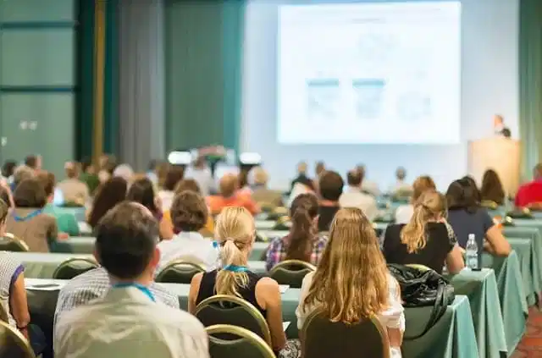
DEFINITIONS
A meeting to exchange knowledge and opinions in order to reach a conclusion on a particular issue.
In the field of education, seminars are a course offered to students to collaboratively study problems and hold discussions.
In other fields, it is a meeting aimed at seeking new approaches and ideas, exchanging knowledge, and finding solutions to problems together.

Slide 4
HISTORY OF SEMINAR
The History of Seminars
The word "seminar" originates from the word "seminarian.
"It originated in monastic institutions in Christianity, which served to produce religious teachers.
The teaching methods of monastic institutions tended to give students freedom in independent thought and research.

Slide 5
HISTORY OF SEMINAR
In 1694, the first seminar teaching took place at the University of Halle in Germany.
In 1869, Charles Kendel Adam experimented with seminar teaching with history students at the University of Michigan in the United States.
From then on, seminar teaching became more widespread, especially at John Hopkins University in 1875.

Slide 6
The importance of the seminar.
It aims to acquire knowledge, ideas, and experiences through meetings, gatherings, and discussions that facilitate the exchange of experiences, and to use the acquired information to improve and develop people, work, and other resources.
The objectives of the seminar are:
  To train, educate, explain, advise, instruct, cultivate attitudes, and provide consultation on related matters.
  To consider, explore, and examine the problems raised in order to understand the knowledge required.
  To present interesting, up-to-date, and relevant information.
  To seek agreement through discussion under a given topic.To make decisions, establish policies, or provide guidelines for implementation.

Slide 7
Benefits of the seminar
The seminar can be organized effectively.
Seminar participants gain knowledge and concepts to apply in their work and life.
The results of the seminar for participants will lead to increased work efficiency.
It reduces the workload of supervisors because subordinates understand the work procedures.
It develops employees to be always ready.
It promotes the advancement of employees.
It fosters creativity and initiative.
It builds good understanding among colleagues, improves interpersonal skills, promotes cooperation, and enables teamwork.

Slide 8
Goals and objectives
Seminar participants are expected to act as both givers and receivers, exchanging knowledge and experiences
In order to find solutions and collaborative approaches.
The heart of the seminar is the active participation of all members in expressing their opinions and offering ideas to the group.

Slide 9
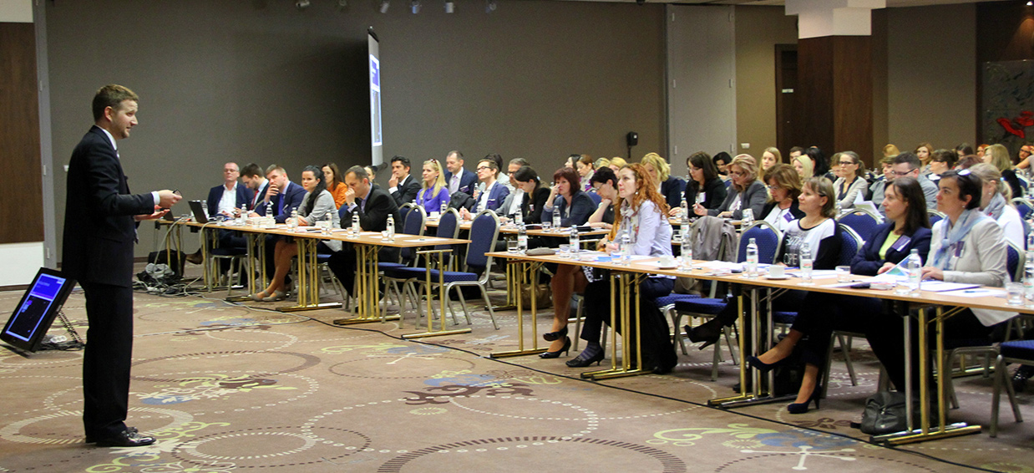
Components of the seminar.
A seminar is a meeting and teaching method where a group of individuals come together to express their opinions, using principles, reasons, experiences, and knowledge to offer suggestions, exchange ideas, and collaboratively find solutions to problems successfully. Alternatively, the approaches learned from the seminar can be used to improve or develop future seminar operations.
Each seminar has six key components:
  Content
  Personnel
  Seminar Methodology
  Venue
  Time
  Budget

Slide 10
Components of a seminar (in terms of content)
Content elements include the substance of the topics, systematically arranged in a logical sequence, comprising the following details:
The title or project name for the seminar should be carefully considered to ensure it yields worthwhile benefits.
Factors to consider when choosing a title include:
  It should address a problem or seek solutions related to your work or current studies, and be a topic you are proficient in and deeply knowledgeable about.
  It should be up-to-date and relevant to the current situation.
  It should allow for the systematic definition of the problem and the identification of solutions.
  It should not be too broad or too narrow; it should have a specific scope, clearly defining the problem and the approach for conducting the seminar.

Slide 11
Components of a seminar (in terms of content)
2. The objectives of the seminar should be clearly stated to define the goals or desired outcomes, such as:
  To study and explore a specific problem of interest.
  To obtain methods or approaches to solve a specific problem.
  To conduct research on a matter of urgent need.
  To learn and exchange research findings among seminar participants.
  To collaboratively consider and reach conclusions on research findings on a topic of interest.

Slide 12

Components of the seminar (personnel aspect)
Personnel components refer to the individuals involved in organizing each seminar.
These include the following personnel:
  Seminar organizing staff or the seminar organizing committee
  Speakers
  Seminar participants

Slide 13
Components of the seminar (personnel aspect)
1. Seminar Organizing Personnel or Organizing Committee
Chairperson and Vice-Chairperson
Secretary and Assistant Secretary
Registrar and Registration Committee
Documentation Committee and Subcommittee
Treasurer and Assistant Treasurer
Venue and Equipment Committee
Organizing Committee (Continued)
Catering and Refreshments Committee
Public Relations (PR) Committee
Reception and Hospitality Committee
Medical and First Aid Committee
Evaluation and Assessment Team

Slide 14
Components of the seminar (personnel aspect)
2. Speakers / Resource Persons
  Experts who provide knowledge and share experiences with participants.
  3. Participants / Attendees
  Individuals sharing common problems.
  Those seeking new ideas together.
  Individuals wishing to exchange opinions with one another.
  Those who want to share knowledge and experience to find collective solutions.

Slide 15
Elements of a seminar (Seminar methodology)
Seminar Methodology
1. Lecture of Speech
    Presenting a story orally is a quick way to deliver a story in a structured manner.
  2. Forum
    There are no strict rules or regulations; questions are asked and answered.
  3. Group Discussion
    Subgroups were formed to discuss and propose areas of interest in subtopics
    Find ways to reach an agreement for the group.

Slide 16
Elements of a seminar (Seminar methodology)
Seminar Methodology
4. Workshop
  Emphasis is placed on hands-on learning and increased participation.
  Work is organized into groups with shared backgrounds and interests, working in small teams under the guidance of mentors and experts.
  5. Demonstration
  Demonstrating the process or steps involved.
  Advantages: Shows the actual process, leading to quick understanding.
  Disadvantages: Suitable only for small groups.

Slide 17
Elements of a seminar (Seminar methodology)
Meeting/Session
  A free and open discussion on a particular topic.
  Field Trip/Study Trip
  Brainstorming
  Participants freely express their opinions.
  Video/Slide Show
  Team building activities, such as identifying problems to be solved together.

Slide 18

Seminar components (including venue)
The venue component refers to the location, tools, or equipment used to organize the seminar. Each seminar should include the following:
Large meeting rooms
Medium or small meeting rooms
Reception rooms
Snack room/Relaxation area outside the meeting room
Dining room
Audio-visual equipment
Tools and equipment
Stationery and office supplies

Slide 19
Seminar components (time constraints)
Timing is a crucial element. Setting the date and time for a seminar is essential. Seminar organizers should plan carefully to ensure a smooth and enjoyable experience for all parties involved. When scheduling, the following factors should be considered:
Timeframe for preparation:
Inviting speakers
Date and time of the seminar

Slide 20
Components of the seminar (budgetary aspects)
Budgetary Components: Organizing a seminar involves significant operational costs. The organizing committee must plan expenses carefully. Considerations when preparing the seminar budget include:
Prepare an expense estimate.
Identify all costs related to necessary materials and equipment that need to be purchased.Create a consolidated budget.
Hold meetings with each responsible party.
  Once each party's budget has been approved, the expenses from each party must be included in the project.
  A detailed breakdown of expenses from each party may be attached to the project for consideration and approval by management or supervisors.

Slide 21
Seminar process
The seminar process or procedure consists of three main steps:
Preparation phase before the seminar
Phases during the seminar
Post-seminar evaluation

Slide 22
Seminar process
Preparation steps before the seminar.
Prepare a seminar project proposal to present to the teacher or supervisor for approval.
Gather information and content from the proposed seminar topic, analyze the content framework, and create a seminar schedule.
Appoint a seminar committee.
Create the seminar schedule and prepare supporting documents.
Publicize the seminar project to relevant parties.

Slide 23
Seminar process
Prepare a registration form and profiles for seminar participants.
Send a letter to the relevant agency, organization, or educational institution requesting their consideration for participation in the seminar, outlining the qualifications of the participants and including seminar details for promotional purposes.
Send a letter notifying the agency, organization, or educational institution of the names of those selected to participate, including any necessary documents and requirements.
Regarding speakers: Prepare details for the participants and contact speakers informally beforehand, outlining the course objectives, topic, scope of presentations, and other relevant details, as well as inquiring about any specific speaker requirements.

Slide 24
Seminar process
Prepare documents and the venue. Prepare folders for distribution to seminar participants. These folders should contain the seminar project outline, seminar schedule, seminar handbook, participant list, participant list, seminar materials, and blank paper for taking notes from the speakers. Prepare registration folders. Prepare evaluation tools. Design and print certificates. Prepare beverages for seminar participants. Plan the use of the seminar venue, room arrangement, and audiovisual equipment to be used each day. Create signs with the seminar project name, speaker names, participant names, directional signs to the seminar room, registration signs, and other necessary signs.

Slide 25
Seminar process
Regarding the opening and closing ceremonies of the seminar.
  Prepare an operational plan for the opening and closing ceremonies of the conference/seminar. Inform relevant parties to prepare for the opening and closing ceremonies, draft opening and closing remarks, and create invitation letters for the seminar chairman, including the schedule and templates for opening and closing remarks. Send invitation letters to speakers and distinguished guests.
  Check the readiness of the seminar venue, registration table, equipment, seating area, altar, vases, and floral arrangements before the opening day. Verify the accuracy of the title, date, time, and location as indicated on the backdrop of the seminar stage.

Slide 26
Seminar process
Procedures to be followed during the seminar.
Organize attendance files.
Explain the seminar schedule.
Distribute provided documents to each participant.
Welcome and assist with various arrangements, including accommodation and explanations.
  Introduce the use of various equipment and tools as requested by the speaker.
  Introduce the speaker and thank them when the seminar ends.

Slide 27
Seminar process
Facilitating the seminar for participants and ensuring the schedule was followed.
Preparing thank-you gifts for the speakers after their presentations, as shown in the image of the gift-giving ceremony.
Dividing into small groups: Holding small group meetings to study, analyze, summarize key points, and provide suggestions, solutions, or approaches to solving various problems. Following this, a general meeting was held to report the results of the meeting, including the problem-solving approaches of each small group. A general discussion and evaluation of the seminar were then conducted.
Closing Ceremony: The chairman delivered the closing speech, congratulating the participants on the successful completion of the seminar and the achievement of its objectives. He praised the unity and participation of all parties involved.

Slide 28
Seminar process
Post-seminar evaluation phase.
Analyze and evaluate the seminar results.
Report the seminar results to the supervisor.
Handle budget and other expenses properly.
Analyze and follow up on the seminar results.

Slide 29
Personnel involved in organizing the seminar.
President
Vice President
Secretary
Assistant Secretary
Registration Department
Documentation Department
Facilities Department
Welfare Department
Treasurer Department
Public Relations Department
Technology Department

Slide 30
Duties and responsibilities of personnel in organizing a seminar.
Chairman; the person presiding over the seminar.
The president should have a good personality, which is a personality that is expressed physically and mentally.
  Dress respectfully and elegantly, and be emotionally stable.
  Have a polished demeanor, be calm and composed, and keep your word.
  Speak politely, be trustworthy, and highly responsible.
  Always have a cheerful and smiling face, and be patient and tolerant.
  Be self-confident and quick-witted.
  Excellent at coordinating and problem-solving.
  Bold and decisive, and flexible.

Slide 31
Duties and responsibilities of personnel in organizing a seminar.
2. The Vice President is the person who assists the President in organizing the seminar. If the President is unable to perform their duties, the Vice President will act in their place.
3. A secretary is a person who performs the following important duties:
  3.1 Preparing for the meeting.
  3.2 Preparing seminar-related documents.
  3.3 Preparing office supplies and documents.
  3.4 Preparing the appointment order for the seminar organizing committee.
  3.5 Drafting the opening and closing remarks for the seminar.
  3.6 Ensuring the seminar venue is ready.
  3.7 Preparing all seminar-related documents for immediate use.

Slide 32
Duties and responsibilities of personnel in organizing a seminar.
4. Assistant Secretaries and Secretariat Subcommittees:
These personnel assist the secretary in all aspects of the process.
5. Registration Department and Committee:
This group of individuals is responsible for preparing all arrangements for seminar participants. Their duties include:- Survey the number of seminar participants.
  - Prepare registration form folders.
  - Create name tags for seminar participants.
  - Divide seminar participants into smaller groups if necessary.

Slide 33
Duties and responsibilities of personnel in organizing a seminar.
6. The Documentation Subcommittee is a group of individuals responsible for preparing various printed materials, including photocopying, stapling, and binding all documents related to the seminar as assigned by the Secretariat, and documents assigned by the Chairman.
7. The Venue Committee is a group of individuals responsible for arranging the venue, coordinating with all parties regarding the format, convenience of the venue, sound system, audiovisual equipment, efficient use of space within the seminar room, testing air conditioning for optimal performance before the actual event, and arranging floral decorations on the tables and in front of the stage.

Slide 34
Duties and responsibilities of personnel in organizing a seminar.
8. The Welfare Committee is responsible for arranging food and beverage welfare, preparing containers for drinks and snacks, and coordinating with the registration and venue departments.
Characteristics of Welfare Committee personnel include being tasteful, patient, calm, honest, highly responsible, cheerful, and prudent.
9. The Treasurer Committee is responsible for managing the accounts and budgets of each department, auditing budgets, and answering questions from all parties. They must maintain records of income and expenses.
10. The Public Relations Committee is responsible for disseminating information about the seminar to the target audience through various media such as the internet, radio, billboards, posters, brochures, etc.

Slide 35

Duties and responsibilities of personnel in organizing a seminar.
Personality traits of a public relations officer.
Possesses good interpersonal skills.
Skilled in public speaking and writing.
Has a positive attitude towards organizing seminars.
Is dedicated to their work.
Is optimistic.
Has a service-oriented attitude.
Is polite and humble.
Is creative and innovative.
Is highly responsible.

Slide 36
Duties and responsibilities of personnel in organizing a seminar.
11. A speaker is a person who transmits knowledge, skills, experience, and useful ideas to the audience, enabling them to gain knowledge, develop creative thinking, and apply the acquired knowledge for the benefit of their organization, society, and the public.
Speaker's personality traits.
Highly responsible
Flexible and enthusiastic
Good interpersonal skills
Patient and resourceful in problem-solving
Good at handling immediate situations.
Creative and innovative.
Modern and broad-minded.
A good role model.
Friendly and unpretentious.

Slide 37
END

