Slide 1


Human Capital Development & Sustainable Development

Slide 2
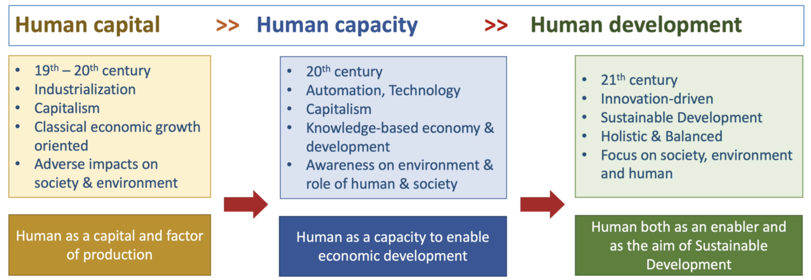

Slide 3
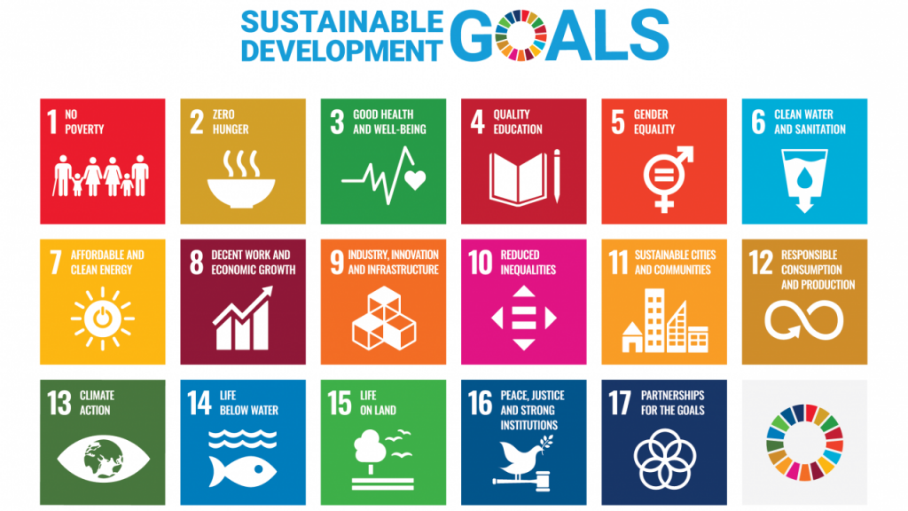

Slide 4

Human Capital Development and Sustainable Development
Human capital development is a cornerstone of sustainable development. It encompasses investments in education, skills training, healthcare, and overall human well-being, all of which are crucial for achieving long-term economic, social, and environmental sustainability.

Slide 5

Human capital development contributes to sustainable development:
Economic Growth:
Social Equity and Inclusion:
Environmental Sustainability:

Slide 6
Economic Growth:
Increased productivity: Educated and skilled individuals are more productive, leading to higher economic output and growth.
Innovation and entrepreneurship: Investments in human capital foster creativity and innovation, driving economic diversification and competitiveness.
Reduced poverty: By enhancing employability and earning potential, human capital development helps reduce poverty and income inequality.

Slide 7
Social Equity and Inclusion:
Reduced inequality: Access to quality education and healthcare can break the cycle of poverty and promote social equity.
Empowerment of women and marginalized groups: Investing in the education and skills of women and marginalized groups is crucial for their economic and social empowerment.
Improved health and well-being: Investments in health and nutrition enhance human capital and contribute to improved quality of life.

Slide 8
Environmental Sustainability:
Green skills and technologies: Developing a skilled workforce in green technologies (renewable energy, environmental management) is essential for transitioning to a sustainable economy.
Environmental awareness and stewardship: Education plays a crucial role in raising awareness about environmental issues and promoting sustainable behaviors.
Sustainable consumption and production: Educated and skilled individuals are more likely to adopt sustainable consumption patterns and support environmentally friendly businesses.

Slide 9

Key Challenges:
Equity and access: Ensuring equitable access to quality education and healthcare for all, especially for marginalized and vulnerable populations.
Relevance and quality: Aligning education and training programs with the needs of the labor market and the demands of a changing economy.
Lifelong learning: Promoting continuous learning and skills development throughout the life cycle to adapt to technological advancements and changing job demands.
Financing human capital development: Securing adequate and sustainable funding for education, healthcare, and social protection programs.

Slide 10

Conclusion: The Path Forward
Human capital is central to achieving sustainable development goals.
Collaboration, investment, and innovation are key to leveraging human potential.
Together, we can create a sustainable and equitable future.

Slide 11
SDGs directly or indirectly rely on human capital development:
Justify with solid example

