Slide 1

Welcome Section
17/7/2025 (Thursday)

Slide 2
Course Orientation
Introduction to the course
Ethics, Morality and discipline
Importance of using English
Making Group
Setting up the rules together

Slide 3
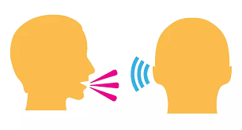

Introduction to the Course
Code and Course Title: EEI 1301 listening and speaking for Teachers of English
Course Description
This course is designed to equip English language teachers with the essential listening and speaking skills necessary for effective communication in diverse professional and social contexts. The course emphasizes the development of both receptive and productive oral communication skills, focusing on understanding and analyzing spoken discourse, as well as expressing ideas clearly, coherently, and confidently.

Slide 4
Introduction to the course
EEI1301 Listening and Speaking for teachers of English
Listening and Speaking for teachers of English
Listening
Speaking

Slide 5
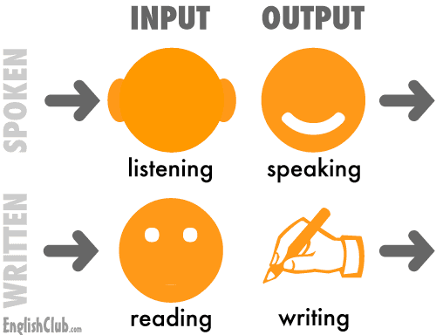
Receptive skills
Productive skills
Input
Output
Listening Skills
Speaking Skills
Podcast Listening
Retelling
Lecture
Discussion, giving opinion

Slide 6

Criteria | Score
Fluency | 1
Vocabulary | 1
Grammar and accuracy | 1
Pronunciation | 1
Eye contact, gesture | 1
Assessment

Slide 7
Resources | Score
TOEIC Listening Test
IELTS Listening Test
Listening

Slide 8
Observation and grading
Ethics and morals and discipline 10%
Attitude towards learning, Attendance, class participation, punctuality
Knowledge and Cognitive Skills 30%
Assignment (Retelling), Presentation, Discussion, Exam, Pronunciation

Slide 9
1. Ethics and Morals
1.1. Ethics and Morals students need to develop
Expressing love, faith, and pride in teaching profession; possessing teacher spirituality; following professional codes of conduct
Developing a public-spirited mindset and personal qualities such as patience, altruism, responsibility, and honesty while completing tasks.
(3) Possessing democratic values and characteristics (respecting others ‘rights and dignity; gaining skills to work together in harmony with others; developing decision making abilities based on objective facts and humanitarian values)

Slide 10
Observation and grading
Interpersonal Skills 30%
Participation, Group work discussion,
group and pair presentation,
Numeral Analysis 10%
Assignment (Research Paper)

Slide 11
Interpersonal Skills and Responsibilities students need to develop
(1) Understanding other people’s feelings; having positive thinking; being mature and able to manage emotions
·(2) Working in team as a good leader and a supportive associate; maintaining good human relationship to students, colleagues, parents, and people in a community; being responsible for public in economic, society, and environment aspects
(3) Being responsible for self-discipline, students, colleagues, and public; providing assistance to others to solve problems creatively
(4) Having academic and profession leadership; having moral courage; being able to teach and share human relationship values to a community and society creatively

Slide 12
Learning Management Skill 20%
Assessed from completed tasks at home
Meet the deadline, End of the exam (mark)

Slide 13
The content to Study
Week 1: Introduction to the course
Language Function: Greeting and farewell
Week 2: The Importance of Listening and speaking skills
Strategies for listening with purpose
Week 3: Asking for giving and refusing permission and suggestions
(listening to the main idea, listening to details) and
listening to sequence.
Week 4: Asking for giving and refusing permission and suggestions
(B) TOEIC listening test practice
Week 5: Agreeing, disagreeing and apologizing
(B) TOEIC listening test practice
Week 6: Presentation Skills
Role Play

Slide 14
The content to Study
Week 8:Asking for help, obligation and clarification
(B) IELTS listening mock test
Week 9: Asking for help, obligation and clarification (Role Play)
(B) IELTS listening mock test
Week 10: Asking for opinions and information
(B) IELTS listening mock test
Week 11: Expressing Sympathy and forbidding
(B) IELTS listening mock test
Week 12: Expressing Sympathy and forbidding
Role Play
Week 13: Dealing with questions and ending conversations
Week 14: Giving feedback, comment and suggestions
Week 15: Final Test.

Slide 15

Setting up the rules together
Group Work

Slide 16
Classroom Rules and Expectation
Cooperation
(work together, take turns, be patient with one another, show good sportsmanship, help each other, solve disagreement smartly)
Responsibility
(follow directions, work hard, meet the deadline for every assignment, independent, complete all the tasks, use time wisely)

Slide 17
Classroom Rules and Expectation
Empathy
(kind, no bullying, no discrimination, don’t talk about others in a negative way)
Self-Control
(control your emotion and behavior, be a good listener, share ideas)

Slide 18
Classroom Rules
Be on time
Listen ( do not interrupt others)
Speak up (Participate in all activities-group discussion, presentation, share your ideas)
Clean up, switch all the electrical appliances after class)
Be Honest (no cheating, no copying from your friends)
Silence your cell phone
Work hard and be responsible

Slide 19
Go to mentimeter.com
Use code
85110700

Slide 20
Language Function: Greeting and farewell
The Importance of Greetings in English
Greetings are key in English.
-help us talk and connect with others.
When you meet someone new or say hello to friends, your greeting matters a lot.
In English-speaking places, greetings are more than saying hello. They help us build good relationships and feel connected. Using the right greetings shows respect and friendliness, making our talks better.

Slide 21
How Greetings Shape Communication
The greeting you choose can change how a conversation goes.
Saying “Hey, how’s it going?” makes things feel friendly and open.
But, saying “Good morning, pleased to meet you” makes things more formal, good for work or special events.

Slide 22
The Role of First Impressions
First impressions happen fast, and greetings are a big part of them. Greeting someone warmly and with a smile can make a great first impression. This can help us talk well and make friends.
Learning English greetings makes you better at talking and meeting people. Knowing when to use different greetings helps you connect well with others. This leaves a good impression that lasts.

Slide 23
Common Ways to Say Hello
There are many ways to greet others in English. You can use informal greetings for fun times or professional ones for work. Knowing when to use each helps you feel more at ease when talking to others.

Slide 24
Friendly Greetings for Informal Situations
For casual meetings, like seeing friends, you can say:
Hey!
Hi there!
What’s up?
How’s it going?
Nice to see you!
These greetings make things feel friendly and relaxed. They help you connect with people in a personal way.

Slide 25
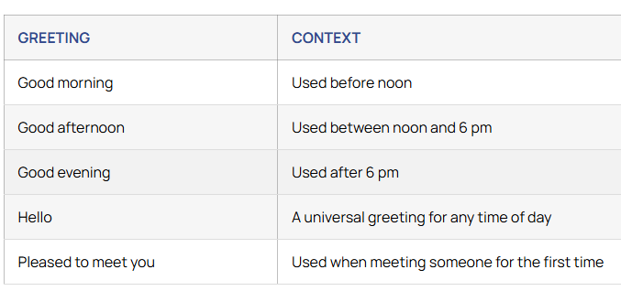
Professional Greetings for Business Settings
In work settings, you should be more formal. Here are some greetings for that:
Using these greetings shows respect and professionalism. It helps you make good connections at work.

Slide 26
Creative Ways to Say Goodbye
Saying goodbye is key in any talk, with friends, family, or workmates. Saying just “bye” or “see you later” works fine. But, learning many creative farewells can make your goodbyes more special and memorable.

Slide 27
Casual Farewells for Everyday Life
When you say goodbye to friends or family, you can be more fun. These casual farewells add a fun touch to your goodbyes:
Catch you later!
See you around!
Until next time!
Take care!
Have a good one!
These friendly phrases show you care and are easy to talk to. They help make your relationships stronger.

Slide 28
Formal Farewells in Professional Contexts
In work settings, it’s important to be polite and respectful. These formal farewells are right for business talks, interviews, or serious meetings:
Thank you for your time.
It was a pleasure meeting you.
I look forward to our next meeting.
Have a wonderful day.
Best regards.
Using these professional goodbyes shows you’re serious and professional. It leaves a good impression on your work friends and bosses.

Slide 29
Enhancing Your Vocabulary with Greetings
Learning English greetings is more than just basic communication. It’s about growing your vocabulary. Using different greetings lets you express yourself and connect with others better.
Expanding Your Greeting Options
While “hello” and “goodbye” are key, there are many more greetings to learn. Try phrases like:
Good morning/afternoon/evening
How’s it going?
What’s up?
Take care
Catch you later
Until next time
Learning more greetings lets you fit into various situations. It shows you’re getting better at English and understanding different cultures.

Slide 30
Using Greetings as Icebreakers
Greetings are great for starting conversations. They help you connect with people. Try these icebreaker greetings:
How’s your day going so far?
Lovely weather we’re having, isn’t it?
I love your [item of clothing/accessory]. Where did you get it?
Have you heard about [current event/news item]? What do you think?
Using these greetings shows you care about others. It helps you start conversations and make friends in English-speaking places.

Slide 31
Thank you

