Slide 1

FINANCIAL ANALYSIS

Slide 2

Financial Analysis
Financial Statement
Definition of Financial Analysis
The Importance of Financial Analysis
Tools of Financial Analysis
The Limitations of Financial Analysis
Summary of Financial Analysis

Slide 3
Financial Statement
A financial statement is a report that shows the financial activities and performance of a business. It is used by lenders and investors to check a business's financial health and earnings potential.

Slide 4
The Importance of Financial Statement
Financial statements provide a snapshot of a corporation's financial health, giving insight into its performance, operations, and cash flow. Financial statements are essential since they provide information about a company's revenue, expenses, profitability, and debt.

Slide 5
The Components of The Financial Statements
There are 5 types of financial statements as :
Balance sheet.
Income statement. Arguably the most important.
Cash flow statement.
Statement of change in equity.
Note to Financial Statements.

Slide 6
The Balance Sheet
Provides a snapshot of the firm's financial position at a specific point in time
Report a company's accounting book value
Presenting its assets , liabilities and stockholders' equity. In its simplest form is represented by the following balance sheet "equation" :
Total assets =total debt + total shareholder equity
Type of Items in the balance sheet are :
- Types of Assets (Current Assets , Long-term Assets and Other Long-term Assets)
- Types of Financing : Debt and equity
Liabilities /debt (Current Liability and Long-term Liability)

Slide 7
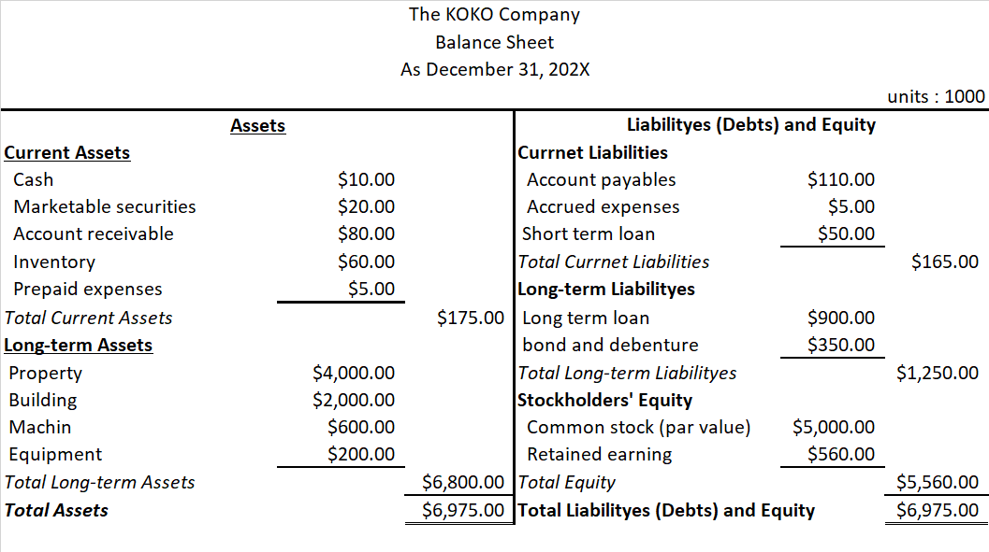
Sample of Financial Statement ( Balance sheet and Income statement)

Slide 8
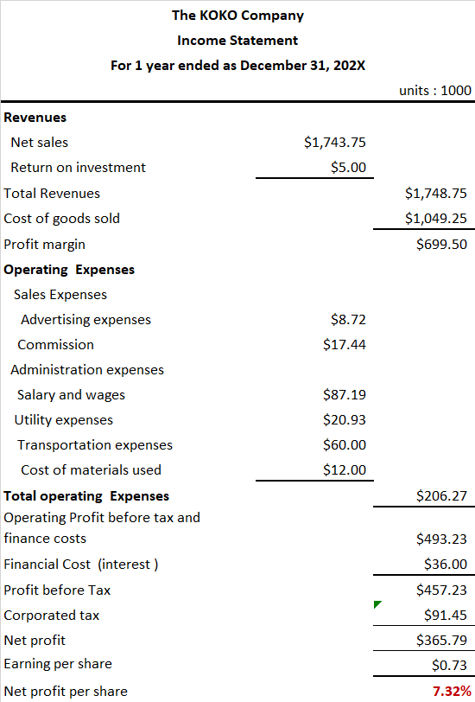
Sample of Financial Statement ( Balance sheet and Income statement)

Slide 9

Definition of Financial Analysis
The process of critical evaluation of the financial information contained in the financial statements in order
to understand and make decisions
regarding the operations of the firm to study of relationship among various financial facts and figures as given in a set of financial statements, and the interpretation thereof to gain an insight into the profitability and operational efficiency of the firm to assess its financial health and future prospects.

Slide 10

The Importance of Financial Analysis
If you want to expand your business, you should know the strengths and weaknesses of the business. The analysis help us see critical relationships that might not otherwise be readily identifiable.

Slide 11

The Purpose of Financial Analysis
To understand the company's financial condition
To determine its creditworthiness, profitability and ability to generate wealth
To provide a more in-depth look at how well it operates internally
To help optimize its management, which could ultimately lead to greater profits and increased financial security
To help optimizing management for greater profits and more financial security

Slide 12
Tools of Financial Analysis
There are 2 Categorize in financial analysis
Percentage Analysis
Ratios Analysis
Comparison:
Times Series Analysis
Cross Section Analysis

Slide 13

Percentage Analysis
3 type of percentage for financial analysis :
Horizontal Analysis
Vertical Analysis
Trend Analysis

Slide 14
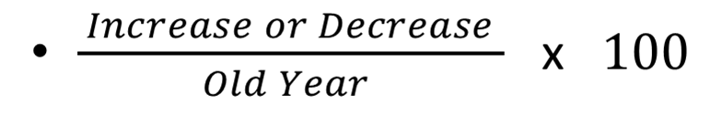
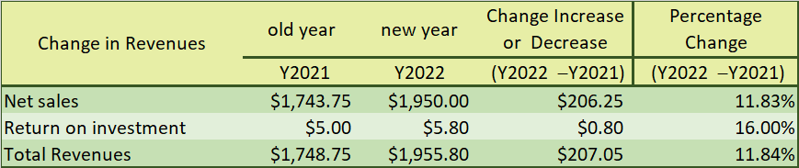
Horizontal Analysis
To comparative financial statement for a different periods of time.

Slide 15


Vertical Analysis
To show the structure of funding and investment in balance sheet .
To show the structure of performance

Slide 16
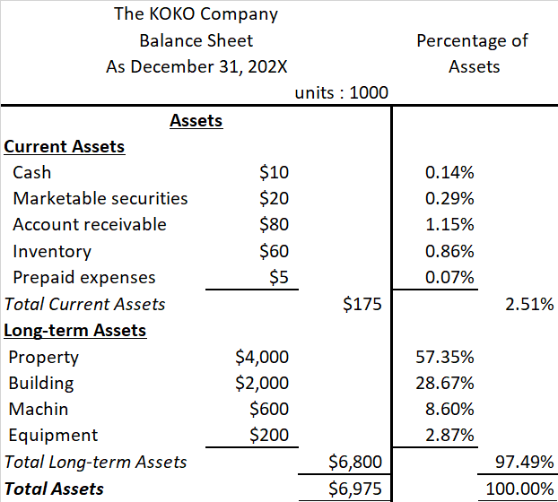
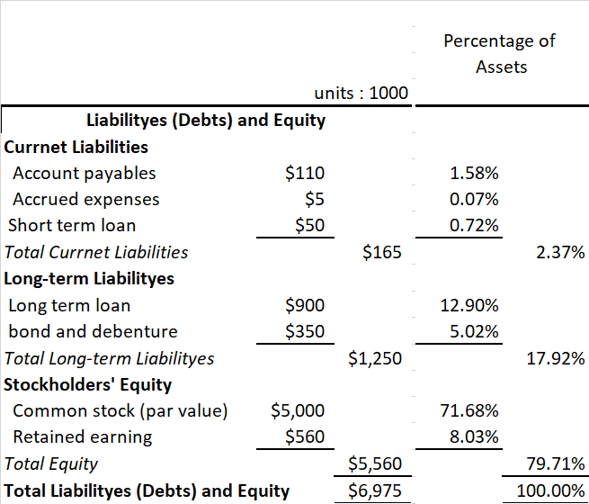
Sample of Vertical Analysis of Balance Sheet)

Slide 17
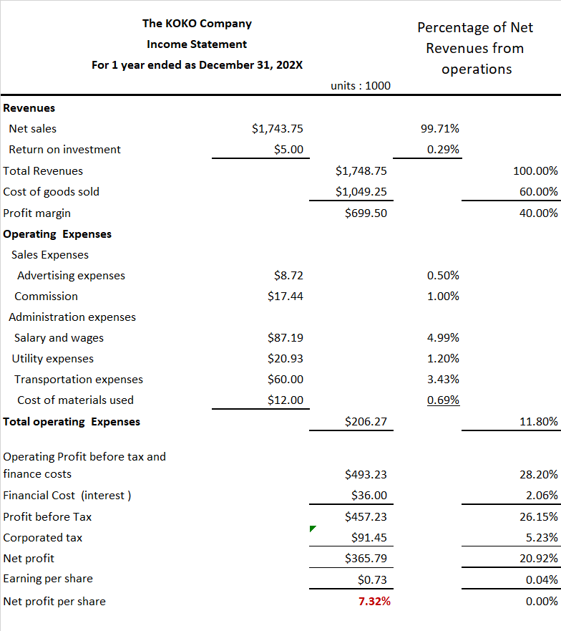
Sample of Vertical Analysis of Income statement)

Slide 18
Ratios Analysis
4 type of ratios analysis :
Liquidity Ratios
Debt Ratios
Profitability Ratios
Coverage Ratios

Slide 19
Liquidity Ratios
Evaluated the ability to pay off short-term debt.
4 formula :
Current ratio
Acid-test Ratio
Liquidity of Receivables
Liquidity of Inventory

Slide 20
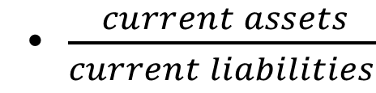
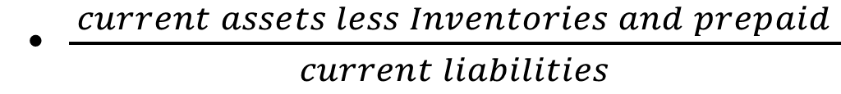
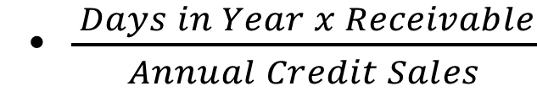
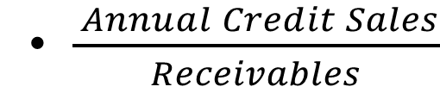
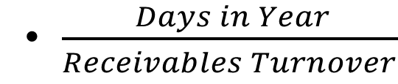
Liquidity Ratios Formular
Current ratio
Acid-test ratio
Liquidity of Receivables
or
Receivable Turnover Ratios
Average Collection Period Ratio

Slide 21
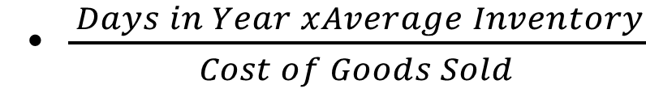
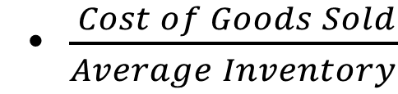
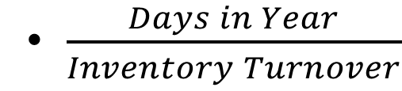
Liquidity Ratios Formular
Liquidity of Inventory
or
Inventory Turnover Ratios
Average Days Sales Ratio

Slide 22
Debt Ratios
Measures the proportion of debt in the capital structure.
2 formula :
Debt to Networth Ratio
Capitalization Ratio

Slide 23
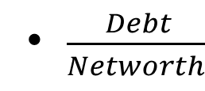
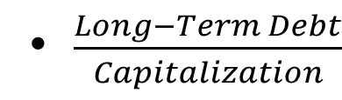
Debt Ratio Formular
Debt to Networth Ratio
Capitalization Rati

Slide 24
Profitability Ratios
measure earning potential
2 type of relation formula
Profitability in Relation To Sales
Profitability in Relation To Investment

Slide 25
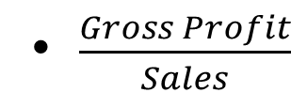
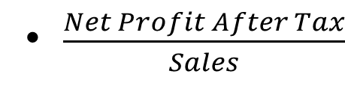
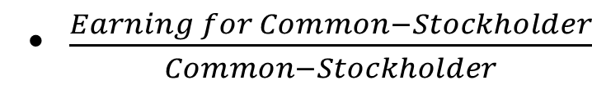
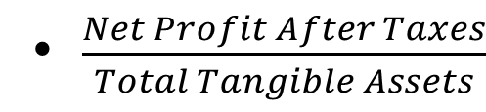
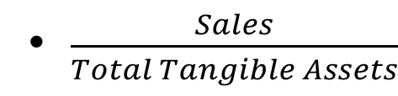
Profitability Ratios Formular
Profitability in Relation To Sales
Gross Profit Margin
Net Profit Margin
Profitability in Relation To Investment
Rate of Return on Common Stock Equity
Return on Assets Ratio
Turnover Ratio

Slide 26
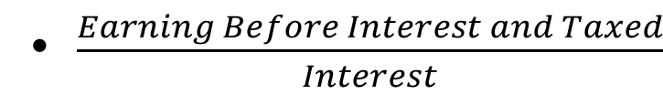
Coverage Ratios
measure ability to pay financial charges
Compare financial expenses.
Formular
Interest Coverage Ratio

Slide 27
The Limitations of Financial Analysis
Finance statement are prepared following GAAP
Finacial statement are only monetary information
Financial analysis does not consider price level changes.

Slide 28
Summary of Financial Analysis
Financial analysis tools can help a wide group of individuals for a variety of purposes. However, in this study we will focus on how the firm itself uses financial analysis tools to evaluate its performance.

