Slide 1


Giving feedback Comment & Suggestions
16th October 2024

Slide 2
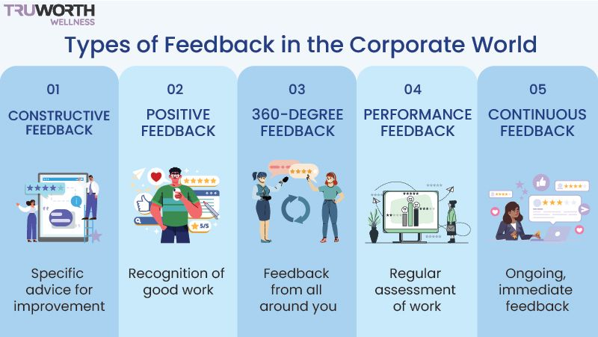

Slide 3
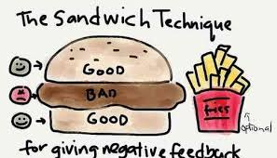
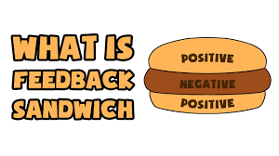
Sandwich method

Slide 4
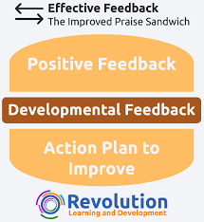
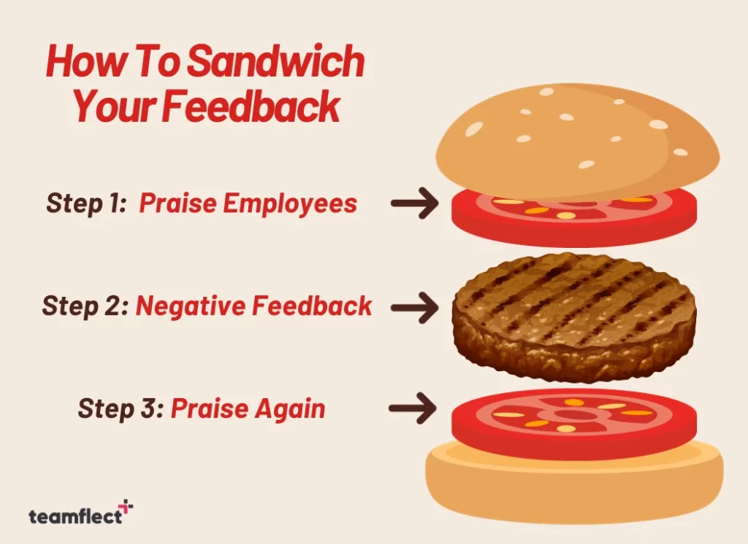

Slide 5
There are three main elements or ingredients in a feedback sandwich:
Step One – Praise Your Employee: This step includes giving praise to soften the negative impact of your criticism on your employees’ confidence.
Moreover, sandwich method claim that by giving praise first, employees will be more open to receiving criticism.
Step Two – Provide Negative Feedback: Add your negative feedback in the middle between the positive feedback examples you are providing.
Step Three – Praise Again: This act aims to end the feedback session on a positive note.

Slide 6
Cons
1. It Can Backfire
by using the feedback sandwich approach, you are technically trying to influence your direct reports without telling them what you are doing. So, this method can feel controlling and it may backfire.
Specifically, your direct reports may not trust your feedback next time because they may think that you are not being transparent with them.
2. It May Not Be Effective Without A Nuancedslide difference Approach
According to a 2019 survey conducted by Gallup, only 26% of employees think feedback works because employees tend to find feedback effective. The lack of openness to feedback may lead to unsatisfactory results when it comes to improving performance.
Result in reverse/opposite

Slide 7
3. May Prevent the Recipient from Focusing on the Negative Feedback
Feedback sandwich influences indirect communication to soften the potential negative impacts of the criticism. So, it can lead to ineffective listening habits among the direct reports.
Specifically, if your employees are receiving praise at the end of the session, they may not pay attention to the negative feedback.
Your employees might assume that you are not highlighting the negative aspects of their performance since they have given praise at the end of the discussion.

Slide 8
Types of feedback As a teacher
Informal feedback
can occur at any times as it is something that emerges spontaneously in the moment or during action.
informal feedback requires the building of connection with students to effectively encourage, coach or guide them in daily management and decision-making for learning. This might occur in the classroom, over the phone, in an online forum or virtual classroom.

Slide 9
Formal feedback
Formal feedback is planned and systematically scheduled into the process. Usually associated with assessment tasks, formal feedback includes the marking criteria, competencies or achievement of standards, and is recorded for both the student and organisation as evidence.

Slide 10
Formative feedback
to monitor student learning to provide ongoing feedback that can be used by instructors to improve their teaching and by students to improve their learning. Formative feedback is best given early in the course, and prior to summative assessments. Formative feedback helps students to improve and prevent them from making the same mistakes again. In some cases, feedback is required before students can progress, or feel capable of progressing, to the next stage of the assessment.
Summative feedback
to evaluate student learning at the end of an instructional unit by comparing it against some standard or level. Therefore summative feedback consists of detailed comments that are related to specific aspects of their work, clearly explains how the mark was derived from the criteria provided and additional constructive comments on how the work could be improved.

Slide 11
Student peer feedback
Providing students with regular opportunities to give and receive peer feedback enriches their learning experiences and develops their professional skill set.
Student self feedback
-ultimate goal of feedback for learning. Teachers have the opportunity not only to provide direction for the students, but to teach them, through obvious modelling and instruction, the skills of self-assessment and goal setting, leading them to become more independent
To help students reach autonomy teachers can clearly identify, share, and clarify learning goals and success criteria; model the application of criteria using samples; provide guided opportunities for self-feedback; teach students how to use feedback to determine next steps and set goals; and allow time for self-feedback/reflection.

Slide 12
Constructive feedback
This type of feedback is specific, issue-focused and based on observations. There are four types of constructive feedback:
Negative feedback – corrective comments about past behaviour. Focuses on behaviour that wasn’t successful and shouldn’t be repeated.
Positive feedback – encouraging comments about past behaviour. Focuses on behaviour that was successful and should be continued.
Negative feed-forward – corrective comments about future performance. Focuses on behaviour that should be avoided in the future.
Positive feed-forward – affirming comments about future behaviour. Focused on behaviour that will improve performance in the future.

Slide 13
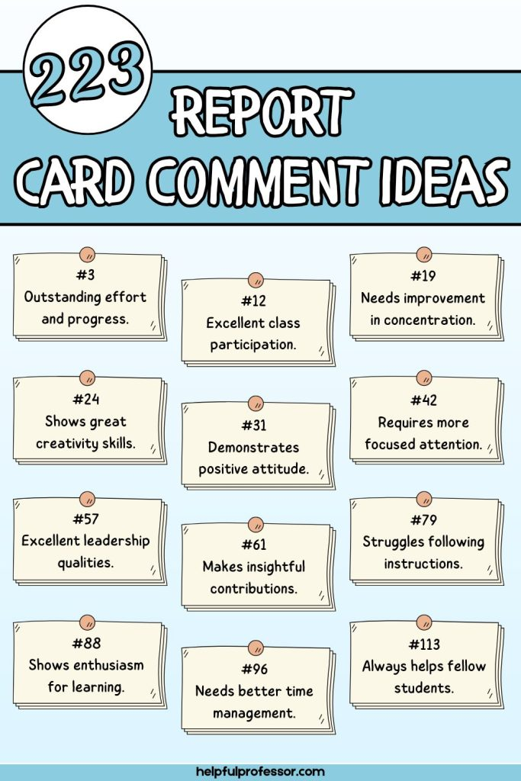
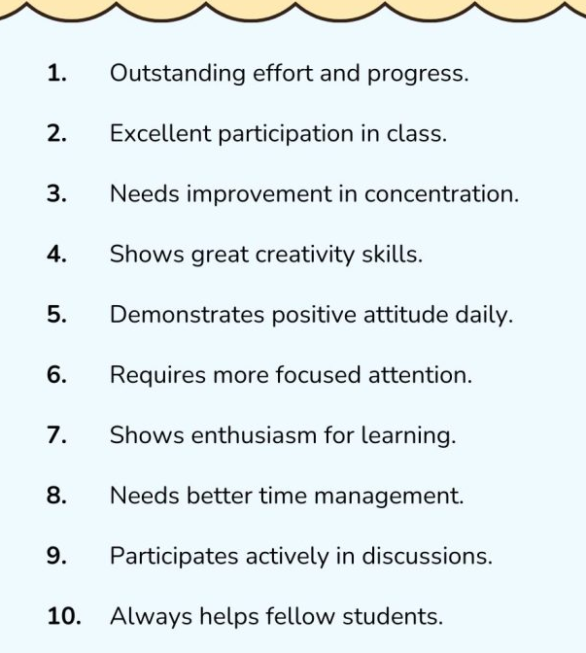

Slide 14
Giving Suggestions
Watch the video and learn some phrases for giving suggestions.
https://www.youtube.com/watch?v=dH7LF_bbHu0

