Slide 1
Studio television production
lectures and practice
Credit : https://en.wikipedia.org/wiki/Television_studio

Slide 2
Studio television production
A television studio, also called a television production studio, is an installation room in which video productions take place, either for the production of live television and its recording onto video tape or other media such as SSDs, or for the acquisition of raw footage for post-production.

Slide 3
Studio television production
The design of a studio is similar to, and derived from, movie studios, with a few amendments for the special requirements of television production. A professional television studio generally has several rooms, which are kept separate for noise and practicality reasons. These rooms are connected via 'talkback' or an intercom, and personnel will be divided among these workplaces.

Slide 4
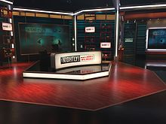
Studio television production
The studio floor is the actual stage on which the actions that will be recorded and viewed take place. A typical studio floor has the following characteristics and installations:

Slide 5
Studio television production
decoration and/or sets
professional video camera (sometimes one, usually several), typically mounted on pedestals
microphones and foldback speakers
stage lighting rigs and the associated Lighting control console, although it is often located in the production control room (PCR)

Slide 6
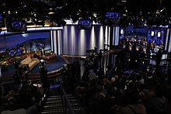
Studio television production
several video monitors for visual feedback from the PCR
a small public address system for communication
a glass window between the PCR and studio floor for direct visual contact is often desired, but not always possible

Slide 7
Studio television production
While a production is in progress, people composing a television crew work on the studio floor.
the on-screen presenters themselves, and any guests - the subjects of the television show.
a floor manager, who has overall charge of the studio area stage management, and who relays timing and other information from the television director.

Slide 8
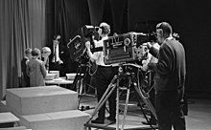
Studio television production
one or more camera operators who operate the cameras, though in some instances these can also be operated from the PCR using remotely controlled robotic pan tilt zoom camera (PTZ) heads.

Slide 9
Studio television production
possibly a teleprompter operator, especially if this is a live television news broadcast

