Slide 1

Week 4 International Market Research & Segmentation

Slide 2
Learning Objectives
What you should learn from Week 4
Understand International Market Research Process
Identify common barriers in international market research.
Apply PESTEL analysis to screen and compare international markets.
Know the Importance of Segmentation

Slide 3

What is international market research？
International market research is a key piece of successful export planning. It is important to critically assess demand for your product and factors related to a given export destination.

Slide 4

International Market Research Process
Step-by-step Guide for Exporters
1. Develop Research Questions
2. Conduct Research (Primary & Secondary)
3. Review Potential Markets
4. Develop an Export Plan

Slide 5

Step 1: Develop Research Questions
- Market size & demand trends
- Competitors & origins
- Standards, certifications, labeling needs
- Duties, taxes, shipping, landed cost
- Pricing competitiveness
- Distribution channels

Slide 6
Step 2: Conduct Research
Primary Research:
- Interviews, surveys, trade shows
Secondary Research:
- Trade statistics (U.S. exports & foreign imports)
- Country & industry reports
- International databases
Trade Data Sources
- Harmonized System (HS) Codes
- U.S. Export Statistics
- Foreign Import Statistics
- UN, World Bank, IMF, CIA Factbook
- Industry associations

Slide 7

Step 3: Review Potential Markets
- Focus on 3-5 countries
- Market growth & sector performance
- FTAs with U.S.
- Regional focus within countries
- Demand trends & competitors
- Tariff/non-tariff barriers

Slide 8

Step 4: Develop Export Plan
- Focus resources on select countries
- Consider time for ROI (months/years)
- Export plan ensures long-term commitment
- Start small, expand strategically

Slide 9

Research Challenges & Walmart Case

Slide 10
Four main research barriers:
Cultural Barriers – Language, consumer norms, social habits.
Infrastructure Gaps – Lack of reliable data in developing/emerging markets.
Legal/Political Restrictions – Regulations, trade barriers, censorship.
Cost & Time Constraints – Expensive and time-consuming to collect global data.

Slide 11
Case Study: Walmart in Germany (1997–2006)
Entered Germany in 1997, exited in 2006 with US$1 billion losses.
Ignored strong local competitors like Aldi & Lidl.
Cultural mismatch:
U.S.-style staff greetings felt uncomfortable for German customers.
Shopping habits different (Germans preferred smaller, closer stores).
Question for Students:
“What data could Walmart have collected to avoid this costly failure?”

Slide 12
Tools – PESTEL & Hofstede
PESTEL Analysis:
Political – Trade laws, tariffs.
Economic – GDP, inflation, consumer purchasing power.
Social – Demographics, consumer behavior, cultural norms.
Technological – Internet penetration, infrastructure.
Environmental – Sustainability, climate policies.
Legal – Labor laws, IP protection, advertising restrictions.

Slide 13
Tools – PESTEL & Hofstede
Hofstede’s Cultural Dimensions (illustrate with country comparisons):
Power Distance: Malaysia (100) vs. Austria (11).
Individualism: U.S. (91) vs. Guatemala (6).
Impact: High power distance = hierarchical decision-making;
High individualism = consumer-driven marketing.
Link to Marketing & Management: negotiation styles, advertising tone, HR policies.

Slide 14

Global Market Segementation

Slide 15
Importance of Segmentation
Segmentation = Key to international marketing strategy
International vs. Global firm:
International firm → Different strategies for different countries
Global firm → World as one market, segmented globally

Slide 16
Three Approaches to Segmentation
Macro-segmentation
Micro-segmentation
Hybrid approach

Slide 17
Macro-Segmentation---Definition
Macro-segmentation or country-based segmentation identifies clusters of countries that demand similar products.
Uses geographic, demographic, socioeconomic factors: Location > GNP per capita > Population size > Family size
Macro-Segmentation --Advantages
Centralized operations
Cost savings in production, sales, logistics, support
Easier to manage regional marketing

Slide 18

Macro-Segmentation ---Limitations
Ignores consumer differences within a country
Risks national stereotyping
Misses cross-border segments
Loses potential economies of scale

Slide 19
Micro-Segmentation ---Definition
Micro-segmentation or consumer-based segmentation involves grouping consumers based on common characteristics using psychographic and/or behavioristic segmentation variables such as cultural preferences, values and attitudes, lifestyle choices.

Slide 20
Micro-Segmentation Bases
Behavioral: Benefits sought, usage patterns
Demographic: Age, race, ethnicity, income
Geographic: Location, regional preferences
Psychographic: Values, attitudes, lifestyles

Slide 21

Advantages of Micro-Segmentation
Captures within-country diversity
Identifies niche markets
Helps tailor marketing campaigns more effectively

Slide 22
Hybrid Approach
Combines macro + micro segmentation
Balances efficiency & customization
Example: Global brand adapting to both country & lifestyle segments

Slide 23

Key Takeaways:
Structured research frameworks prevent costly mistakes.
Cultural insights are critical to market success.
Segmentation = cornerstone of international strategy. Macro → Efficiency Micro → Precision Hybrid → Balance

Slide 24
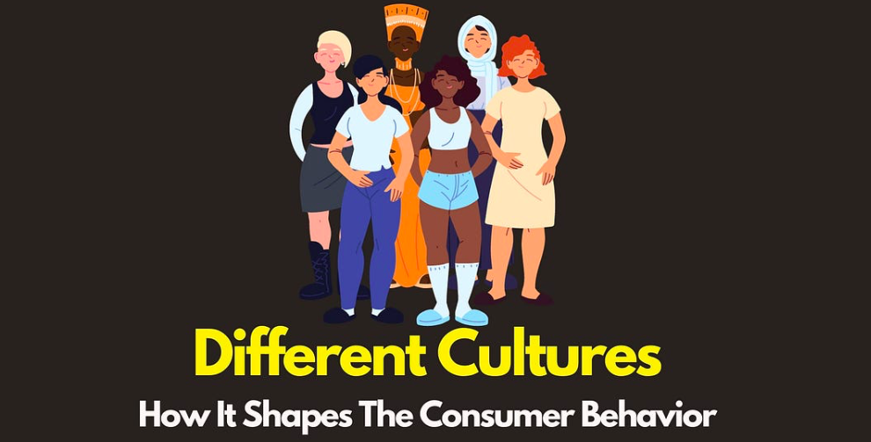
Week 5 Cross-Cultural Consumer Behavior
IBB2402

Slide 25
Learning Objectives
What you should learn from Week5:
Identify how individualism, indulgence, and uncertainty avoidance influence consumer decision-making.
Analyze the impact of culture on e-commerce behavior
Analyze luxury buying behavior across different cultures.

Slide 26

Introduction
Consumer behavior mirrors cultural intricacies.
Businesses must understand cross-cultural patterns.
IBB2402

Slide 27
Cultural Values & Consumer Behavior
Individualism → focus on personal benefits.
Indulgence → focus on pleasure and enjoyment.
Uncertainty avoidance → impacts decision-making.
IBB2402

Slide 28
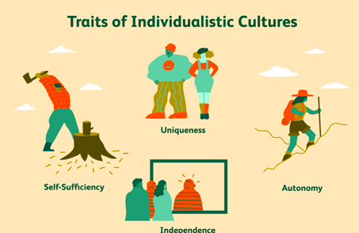
Individualism Example
Highly individualistic cultures (e.g., U.S.):
Products with unique features gain traction.
Personal benefit outweighs social approval.
IBB2402

Slide 29

The Role of E-Commerce
Online behavior still influenced by culture.
Collectivist cultures → rely on community approval.
Trust & security remain critical.
IBB2402

Slide 30
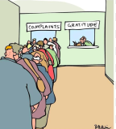
Complaint Behaviors Across Cultures
Some cultures: avoid complaints (high cost, low chance of success).
Others: frequent complaints if product importance is high.
IBB2402

Slide 31

Luxury Consumption
Luxury goods = different meanings:
Social status (symbolic).
Individual or functional value.
IBB2402

Slide 32

Cross-Cultural Implications for Marketers
Brands must tailor tools to cultural expectations.
Messaging, design, and trust-building vary by region.
IBB2402

Slide 33
Key Takeaways:
Cultural Values: Individualism, indulgence, and uncertainty avoidance are cultural values that influence consumer behavior.
E-Commerce Impact: Cultural factors such as language, trust, and social influence play a significant role in e-commerce consumer behavior.

Slide 34
Key Takeaways:
Complaint Behavior: Cultural background affects consumer complaint behavior, with variations in attitudes towards complaining.
Luxury Consumption: Perceptions of luxury goods and motivations to purchase vary significantly across cultures.

Slide 35

Week 6 Expanding Your Brand through Globalization or Localization
IBB2402

Slide 36
Expanding Your Brand: Globalization vs. Localization
Expanding your brand through globalization or localization is a significant undertaking, but one that can propel your business.
“Global branding provides companies with compelling economies of scale in everything from research and development to marketing to operations,”--Harvard Business School Professor Jill Avery
IBB2402

Slide 37
What is Global Branding?
Global branding is when your product or service has a shared brand identity system—such as a consistent name, logo, aesthetic, and messaging—established in most or all parts of the world.
Local execution may vary by market.
Global brands = uniformity across markets.
Multinational brands = operate in several markets, but with localized variations.
IBB2402

Slide 38
Benefits of Global Branding
Centralization: Centrally managing your business strategy—from research to marketing to operations.
Cost & Efficiency: economies of scale, single campaigns, e.g., FIFA sponsorship.
Brand Recognition: easier market entry, positive halo effect.
Consumer Benefits: perception of higher quality, cosmopolitan appeal.
IBB2402

Slide 39
Globalization vs. Localization vs. Glocalization
Globalization: standardized identity, centralized operations (Starbucks, Apple).
Localization: customized identity/strategy (local brands).
Glocalization: global consistency with local relevance (McDonald’s).
IBB2402

Slide 40
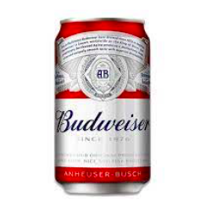
Challenges of Global Branding
What works in one market may fail in another.
Cultural branding mismatch (e.g., Budweiser’s U.S. “authentic beer” identity didn’t resonate in China).
Risk of weakening brand equity with too much adaptation.
IBB2402

Slide 41

Case: McDonald’s
Global brand recognition (Big Mac, fries).
Local adaptation (Veg meals in India, rice burger in Japan).
Competitive advantage = hyperlocal + hyperglobal simultaneously.
IBB2402

Slide 42
4 Steps to Implement Global Branding Strategy
1. Develop a Clear Brand Vision
Brand architecture & portfolio clarity.
2. Standardize
Leverage customer universals & efficiencies.
3. Centralize Brand Platform
Consistent core identity (e.g., Starbucks).
4. Global Consistency + Local Relevance
“ Think global, act local” execution.
IBB2402

Slide 43
THANKS

