Slide 1

https://www.linkedin.com/

Slide 2
IT
Digital literacy
Data analytics
Project management
Soft Skills
Interpersonal Communication
Critical thinking:
Cybersecurity fundamentals
AI and Machine Learning
Adaptability
Leadership
Creativity and innovation
Top 10 skills
In Demand in 2025
https://www.linkedin.com/

Slide 3
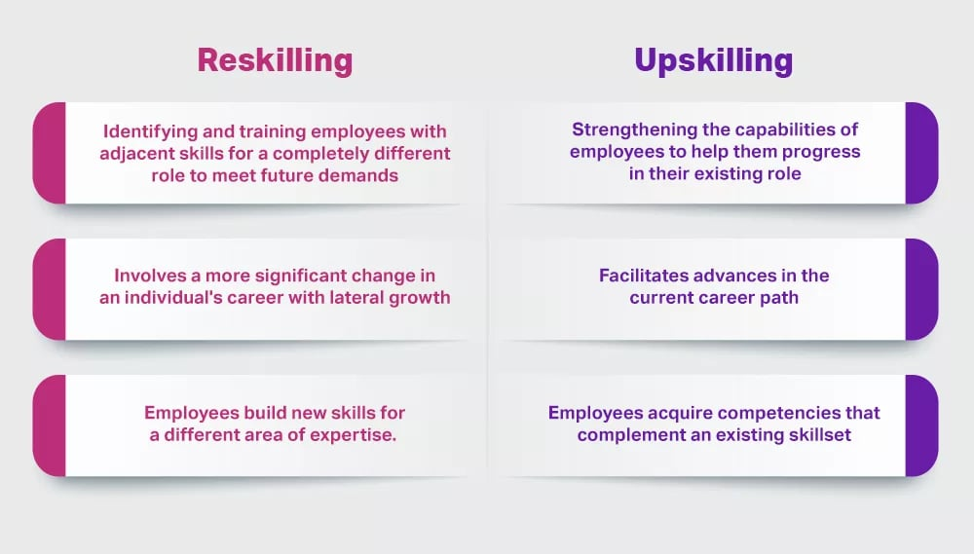
https://disprz.ai/

Slide 4
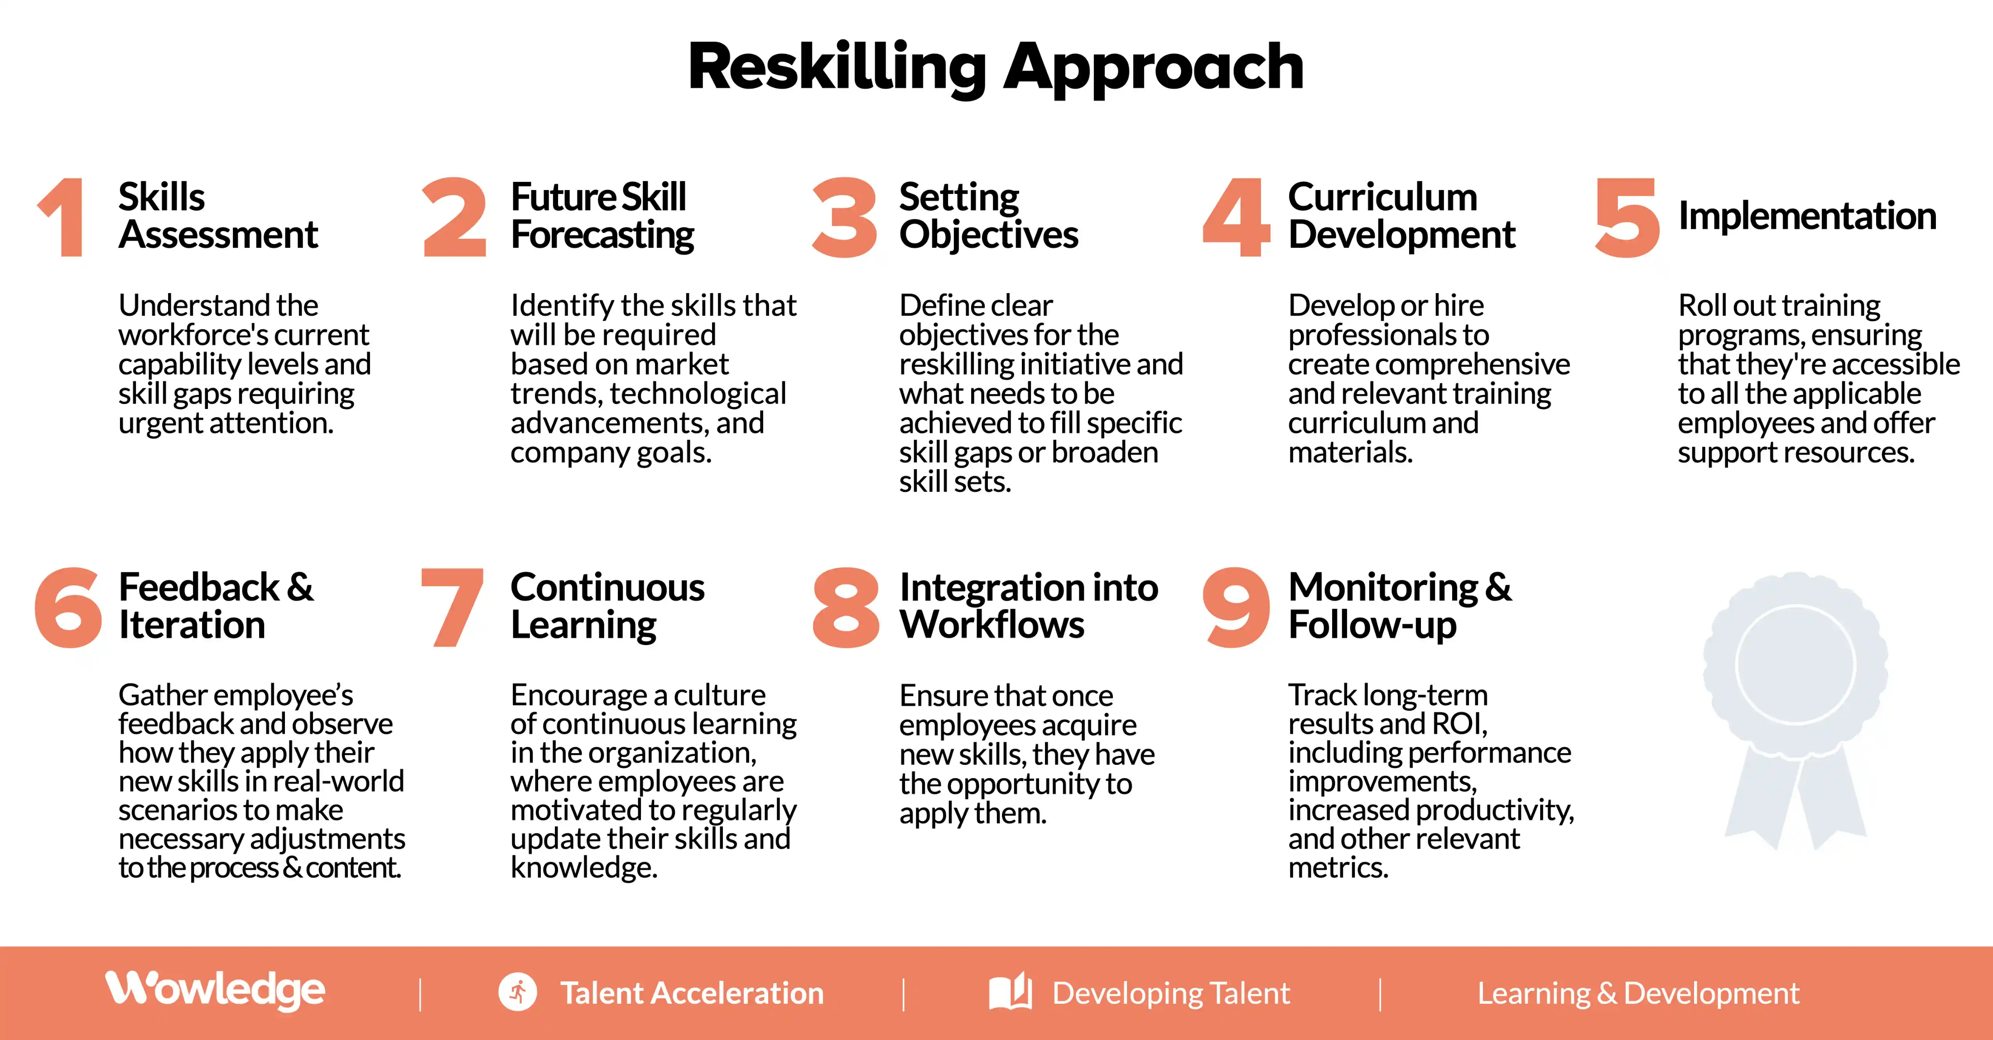
https://wowledge.com/

Slide 5
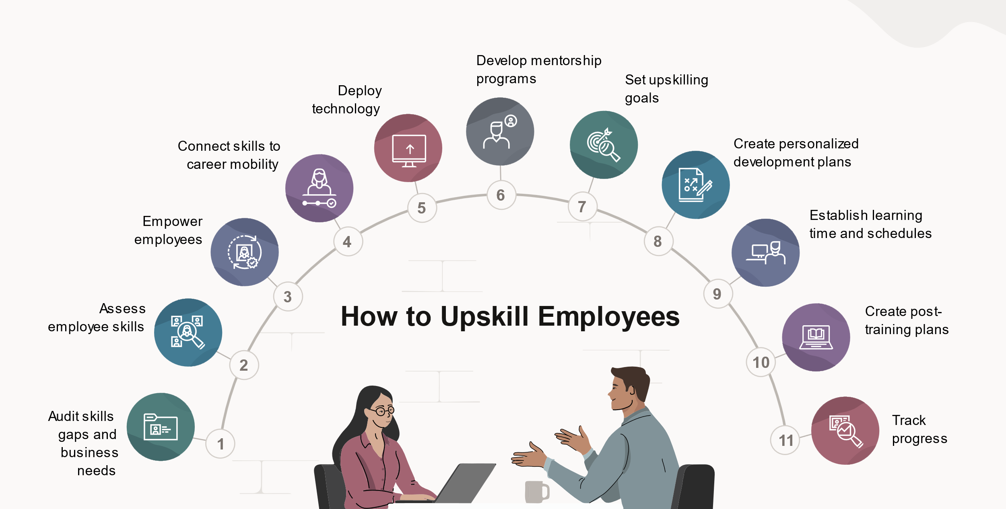
https://www.oracle.com/

Slide 6
Four top strategies for upskilling and reskilling?
Fostering a learning culture
Creating personalized employee learning paths
Encouraging knowledge sharing
Tracking metrics

Slide 7
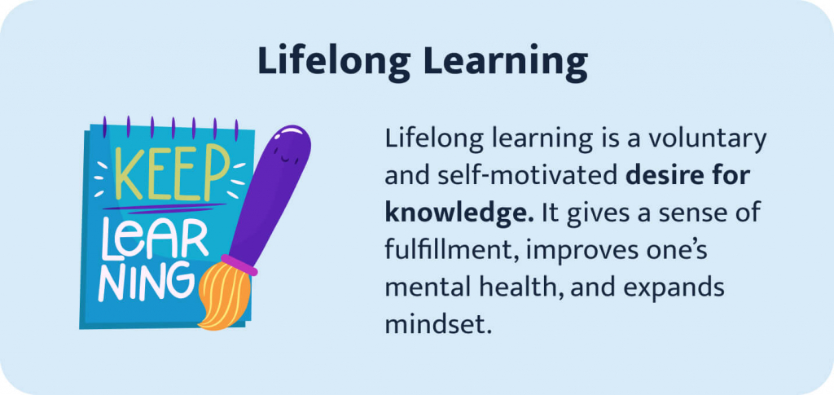
https://custom-writing.org/

Slide 8
Lifelong learning examples
A lifelong learner
In order to enhance instruction,
the experienced Professor
participates in conferences
and seminars.
A first-year student learns Chinese
in the evenings and works
part-time at a convenience store
to gain experience in new environments.

Slide 9
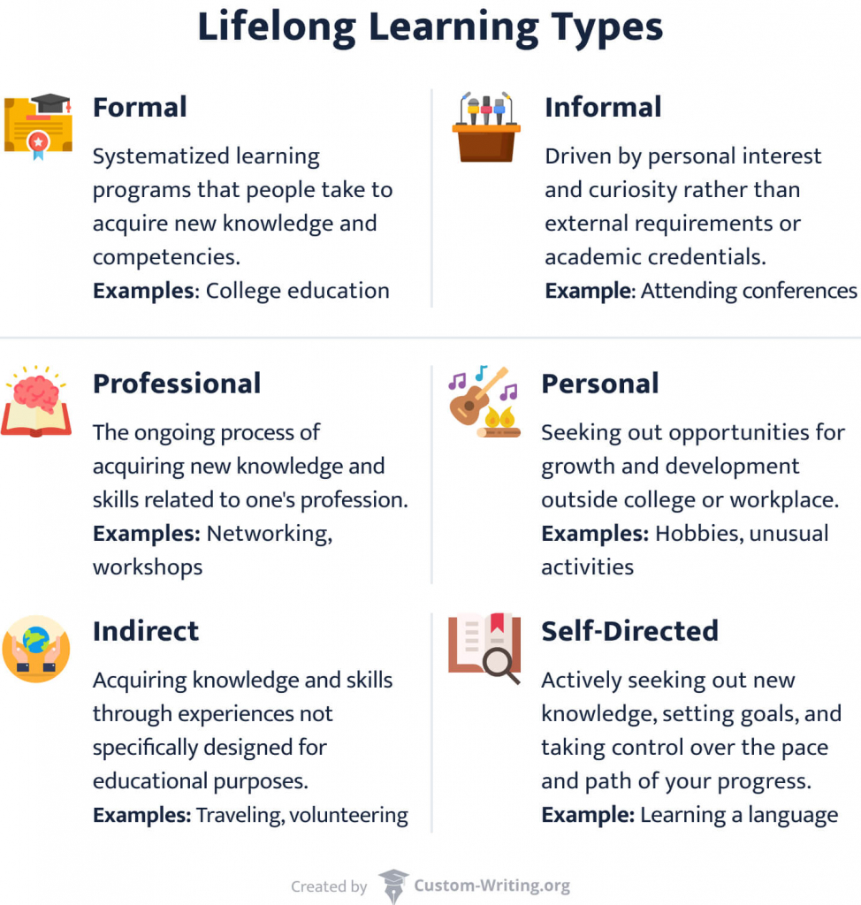

Slide 10
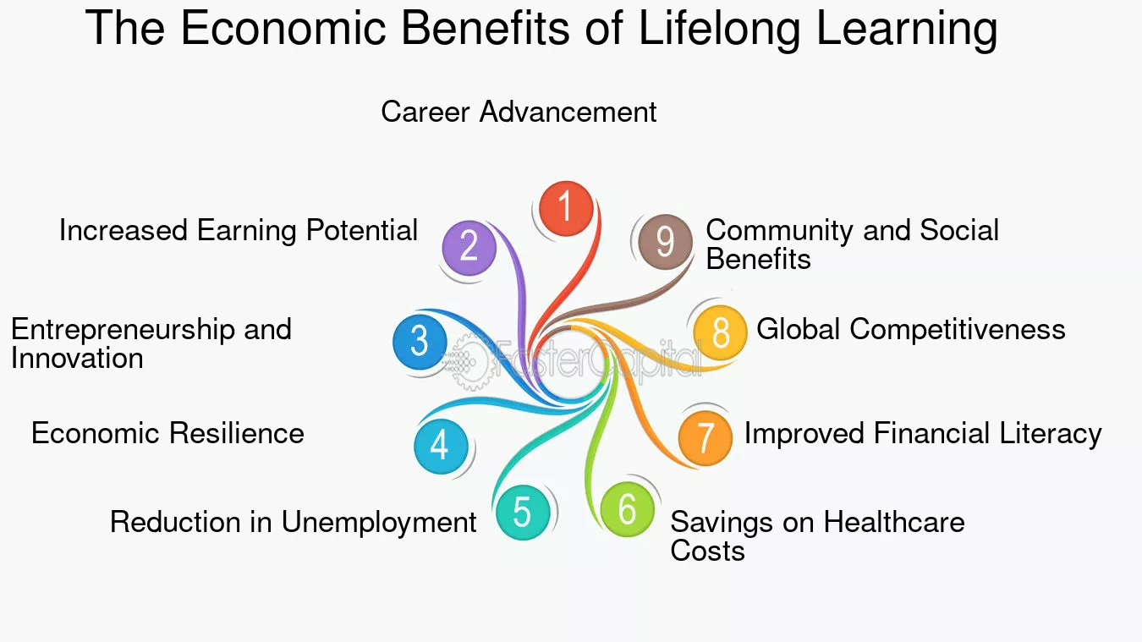
https://fastercapital.com/

Slide 11
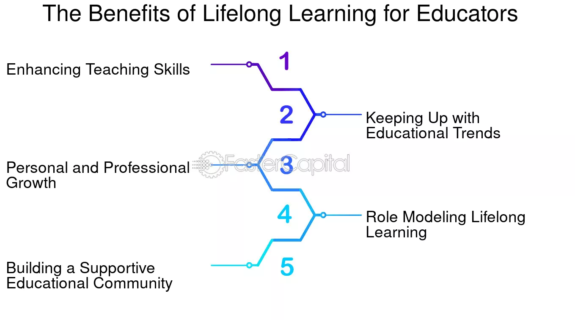

Slide 12
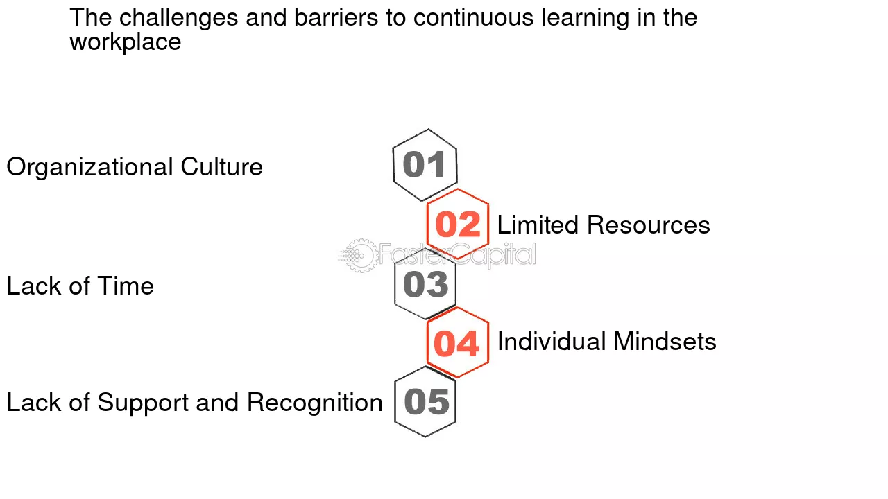

Slide 13
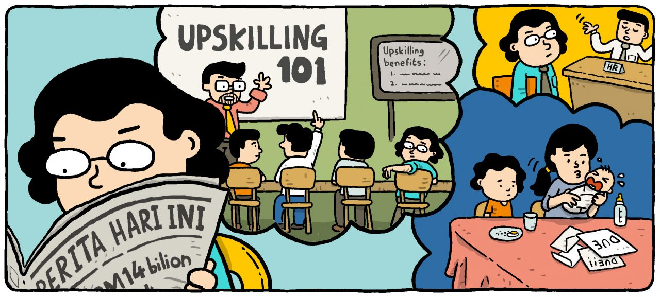
If your organization assigns you the job skills upskill project duty.
How do you go about things? (20 minutes group brainstorming)
https://www.centre.my/

Slide 14
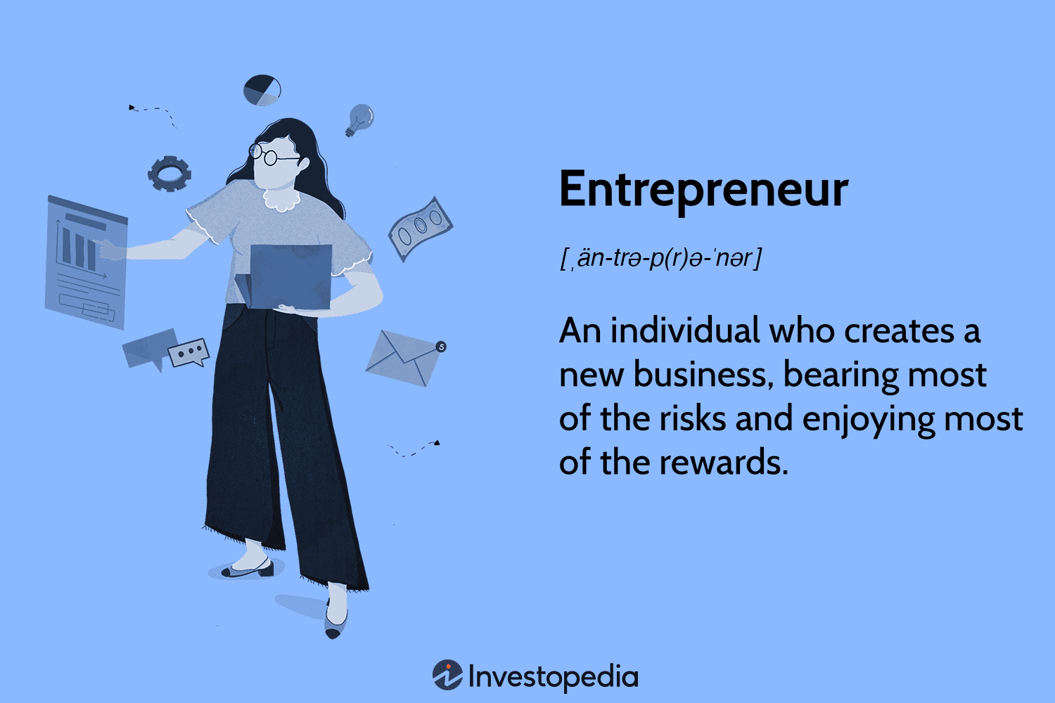

Slide 15
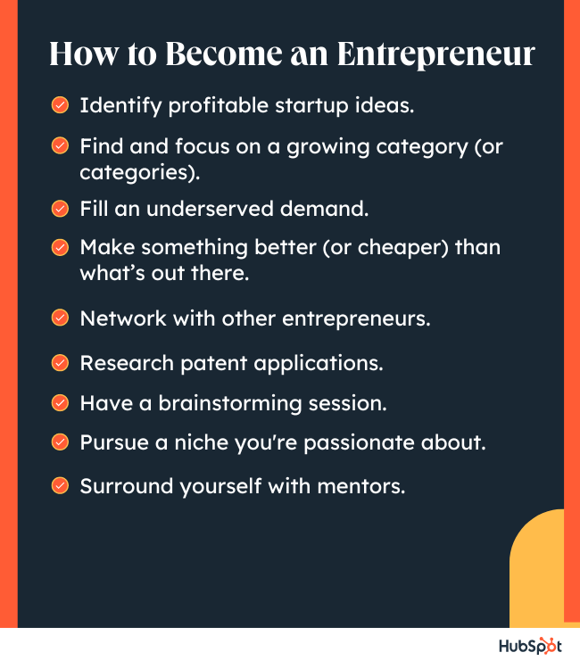
https://blog.hubspot.com/

Slide 16
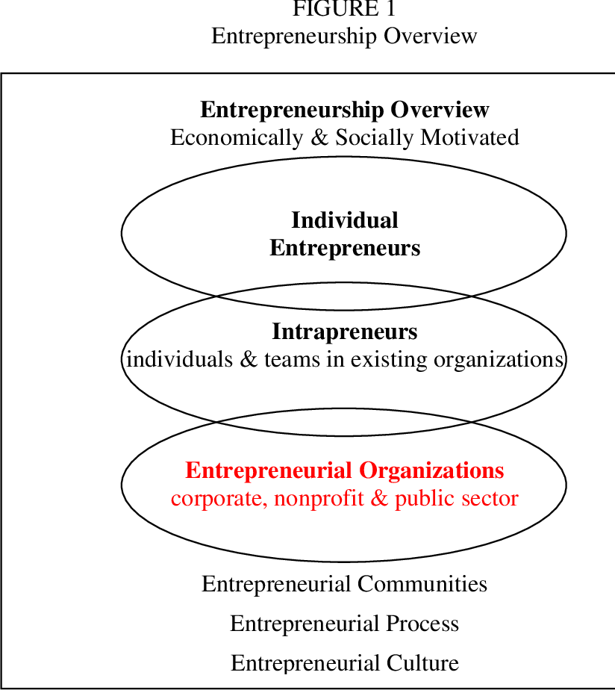
Fox, J. (2005) Organizational entrepreneurship and the organizational performance linkage in university extension
https://www.semanticscholar.org/
This study examined the relationship between
Organizational Entrepreneurship
and Organizational Performance within
the Cooperative Extension System, a national
educational network extending the research-based knowledge
of land-grant colleges and universities.
This study measured both Entrepreneurial Orientation
and Entrepreneurial Management .
Extension Directors nationwide responded to a questionnaire,
reporting on Organizational Entrepreneurship and
Organizational Performance based on both financial and
non-financial indictors.
As Extension organizations address more diverse audiences,
an increasingly complex funding mix, and rapidly evolving
technologies, the field of entrepreneurship offers principles
to continuously improve performance.
https://www.semanticscholar.org/

Slide 17

Story telling
Ask your friend who is the CEO to share his experiences as an independent entrepreneur.
What is the source of his inspiration?
What is the founding process?
What services and goods are offered to customers?
What are the management methods?
How are failures handled?
What accomplishments are you proud of?
Questioning by Listeners
Summary by Note-takers
If there's one vital piece of advice for anyone aiming
to become a successful independent entrepreneur,
it's this…………………………….
.

Slide 18
Assess your readiness for entrepreneuship

