Slide 1
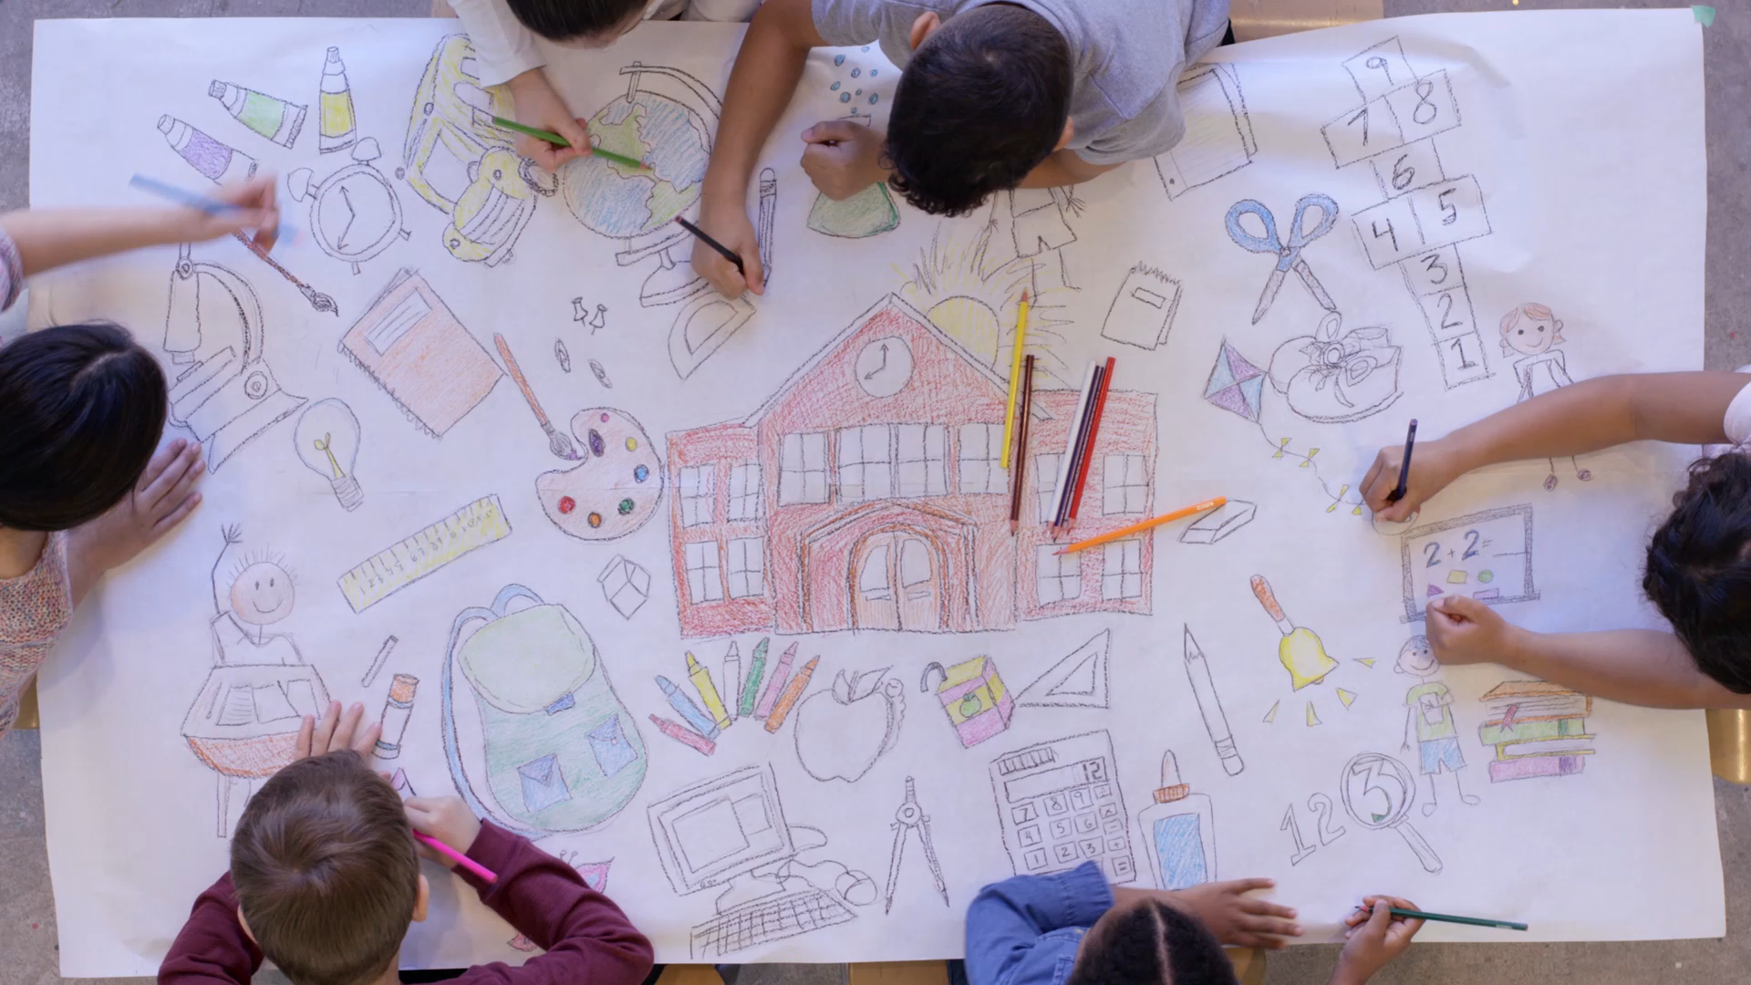
Basic Painting
Course Syllabus, Materials & Fundamental Techniques

Slide 2

Course Overview
A comprehensive foundation in 2D visual arts, color media exploration, and technical execution.

Slide 3

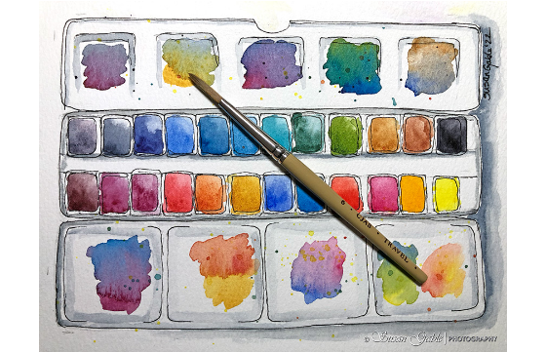
Course Description
•
2D Visual Art Principles: Study core theories, processes, and practical methods of visual expression.
•
Color Media Exploration: Hands-on application of watercolors, gouache, and various color techniques.
•
Design Foundations: Build essential skills applicable to broader design and creative disciplines.

Slide 4






Core Learning Outcomes
Light & Shadow
Proportion & Depth
Composition
Master lighting principles, shadow construction, contrast control, and tonal rendering across objects.
Understand spatial relationships, scale accuracy, perspective distance, and surface texture reproduction.
Develop proficiency in spatial layout, visual balance, focal points, and harmonious structure.

Slide 5
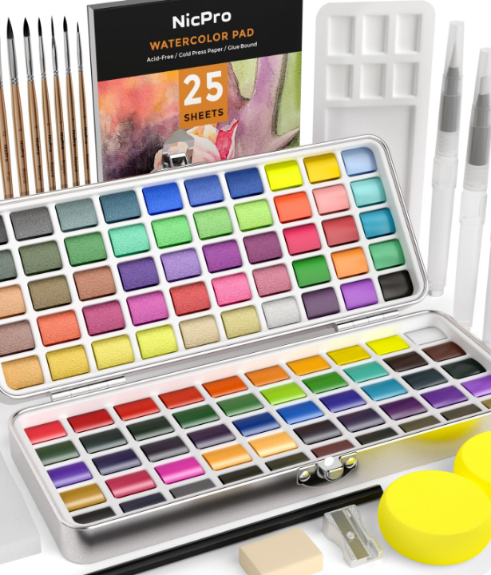
Required Equipment
Essential Materials
Papers & Paints: 100 lb rough watercolor paper (A2 size), tube or pan watercolors, and gouache sets.
Studio Tools: A2 drawing board, standard palette, flower-shaped mixing palette, binder clips, masking tape, wiping cloth, and water container.

Slide 6
Brush Types & Applications
Brush Category | Head & Bristle Shape | Primary Technique & Application
ROUND / RIGGER | Pointed tip with long/thin hair | Fine line work, intricate accents, outlines
FLAT / BRIGHT | Square flat edge, long/short bristles | Rapid broad coverage, bold square strokes
FILBERT / ANGLE | Oval rounded head / slanted edge | Smooth edge blending, versatile detailing
FAN / MOP | Spread fan shape / soft round mop | Foliage/grass textures, large soft washes

Slide 7


Tool Recommendations
Recommended Equipment
Not Recommended
Use standard natural or synthetic bristle brushes with separate water containers. This allows full control over water-to-pigment ratios, which is vital for foundational painting exercises.
Refillable water brush pens (water reservoir brushes) are NOT recommended for this course. They limit manual moisture adjustment during wash and color blending practices.

Slide 8
Practical Assignment 1
Object Sketching Exercise
•
Objective: Practice sketching everyday objects to master structural forms and proportions.
•
Quantity & Format: 50 objects total (5 sketches per page across 10 A4 sheets).
•
Focus Areas: Structural geometry, value shading, and surface texture fidelity.

Slide 9
Sketching Workflow
Step 2
Step 4
Identify light source & apply initial shading
Final review & portfolio page formatting
Step 1
Step 3
Analyze structural geometry & outline forms
Render surface textures & refine fine details

Slide 10
Questions?
Ready to embark on your Basic Painting journey.
Basic Painting Course | Department of Visual Arts

Slide 11



Image Sources
https://susiegstudio.com/wp-content/uploads/2022/09/myartwork_watercolorpalettebrush_watercolor_5838.jpg
Source: susiegstudio.com
http://www.nicpro.com/cdn/shop/files/image_1_8eb0167d-1e05-4ee1-b828-57361ef721dc.jpg?v=1689759023
Source: www.nicpro.com
https://i.ytimg.com/vi/XxnW5h-7W_w/hq720.jpg?sqp=-oaymwEhCK4FEIIDSFryq4qpAxMIARUAAAAAGAElAADIQj0AgKJD&rs=AOn4CLBydguUCUUXyCCJStEtYGcAtM3BjQ
Source: www.youtube.com

