Slide 1

Lesson 9
Managing Transaction Exposure
  Participants will be able to:
  A. Compare the commonly used techniques to hedge payables
  B. Compare the commonly used techniques to hedge receivables
  C. Explain how to hedge long-term transaction exposure
  D. Suggest other methods of reducing exchange rate risk when hedging techniques are not available

Slide 2

Transaction Exposure
MNC must identify its degree of transaction exposure
MNC must consider the various techniques to hedge the exposure so that it can decide which hedging technique is optimal and whether to hedge its transaction exposure.

Slide 3
Hedging Exposure to Payables
Forward or futures hedge allows the MNC to lock in the exchange rate at which it can purchase a specific currency.
Money market hedge involves taking a money market position to cover a future payables position.
Call option hedge on payables provides the right to buy a specified amount of a particular currency at a specified strike price.

Slide 4
Cost of Call Options
Based on contingency graph
Advantage: provides an effective hedge
Disadvantage: premium must be paid
Based on currency forecast
MNC can incorporate forecasts of the spot rate to more accurately estimate the cost of hedging with call options.

Slide 5
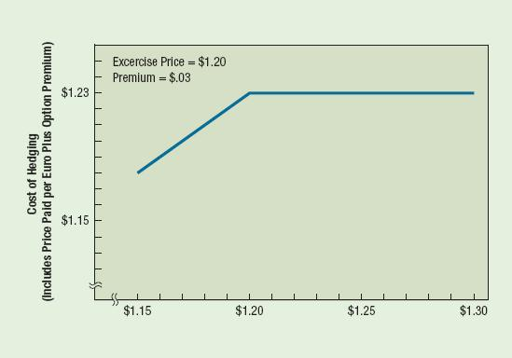
Contingency Graph for Hedging Payables With Call Options

Slide 6

Optimal Technique for Hedging Payables
Select optimal hedging technique by:
  Consider whether futures or forwards are preferred.
  Consider desirability of money market hedge versus futures/forwards based on cost.
  Assess the feasibility of a currency call option based on estimated cash outflows.
Choose optimal hedge versus no hedge for payables
Evaluate the hedge decision by estimating the real cost of hedging payables versus the cost of payables if not hedged.

Slide 7
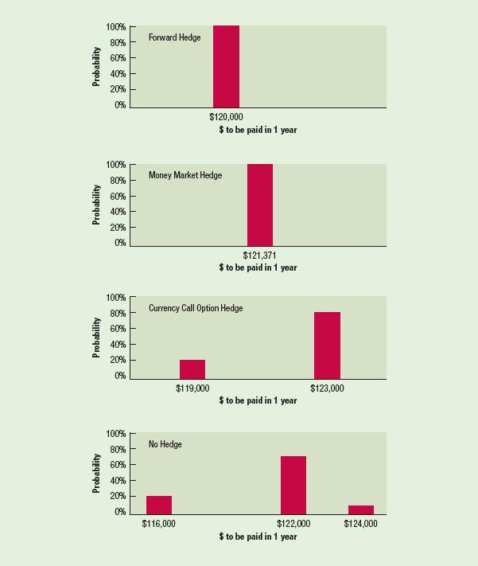
Graphic Comparison of Techniques to
Hedge Payables

Slide 8
Hedging Exposure to Receivables
Forward or futures hedge allows the MNC to lock in the exchange rate at which it can sell a specific currency.
Money market hedge involves borrowing the currency that will be received and using the receivables to pay off the loan.
Put option hedge on receivables provides the right to sell a specified amount of a particular currency at a specified strike price by a specified expiration date.

Slide 9

Cost of Put Options
Based on Contingency Graph
  Advantage: provides an effective hedge
  Disadvantage: premium must be paid
Based on Currency Forecasts
  MNC can use currency forecasts to more accurately estimate the dollar cash inflows to be received when hedging with put options.

Slide 10
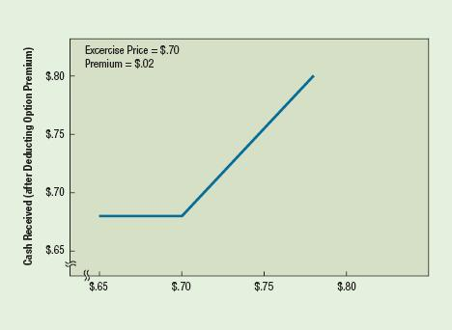
Contingency Graph for Hedging Receivable with Put Options

Slide 11
Optimal Technique for Hedging Receivables
Select optimal hedging technique by:
Consider whether futures or forwards are preferred.
Consider desirability of money market hedge versus futures/forwards based on cost.
Assess the feasibility of a currency put option based on estimated cash outflows.
Choose optimal hedge versus no hedge for receivables
Evaluate the hedge decision by estimating the real cost of hedging receivables versus the cost of receivables if not hedged.

Slide 12
Hedging Policies of MNCs
Hedging most of the exposure
Hedging none of the exposure
Selective hedging

Slide 13
Limitations of Hedging
Limitation of hedging an uncertain amount
Limitation of repeated short-term hedging

Slide 14
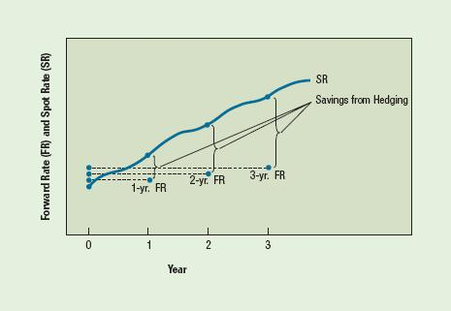
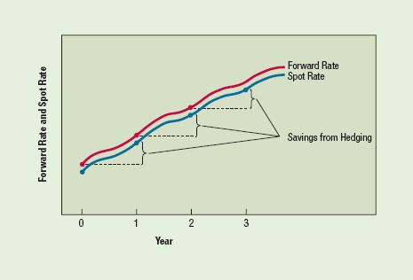
Illustration of Repeated
Hedging of Foreign
Payables When the
Foreign Currency is
Appreciating
Illustration of Long-Term Hedging of
Payables When the
Foreign Currency is
Appreciating

Slide 15

Hedging Long-Term Transaction Exposure
Long-Term Forward Contract: up to 5 years
Parallel Loan:
  Exchange of currencies between two parties with a promise to reexchange currencies at a specified exchange rate on a future date.

Slide 16
Alternative Hedging Techniques
Leading and Lagging: adjusting the timing of a payment or disbursement to reflect expectations about future currency movements.
Cross-Hedging: hedging by using a currency that serves as a proxy for the currency in which the MNC is exposed.
Currency Diversification: reduce exposure by diversifying business among numerous countries.

Slide 17

Knowledge Sincerity Excellence UniMAP

